Slide 1
Food-Borne Illnesses and Sanitation
Foods & Nutrition 1

Slide 2
Microbes Music Video
https://www.youtube.com/watch?v=1EkehFkhWf4&feature=related

Slide 3
Cross Contamination
The process by which bacteria or other microorganisms are unintentionally transferred from one substance or object to another, with harmful effect.

Slide 4
What is a foodborne illness?
Foodborne illness is an infection or irritation of the gastrointestinal (GI) tract

Slide 5
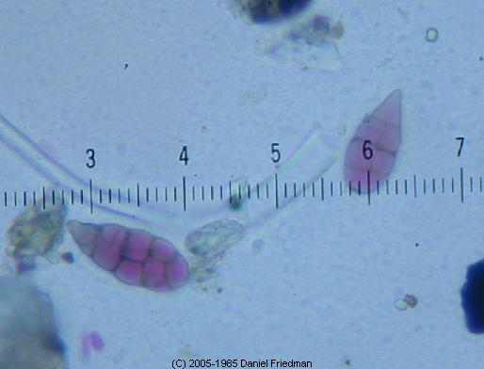
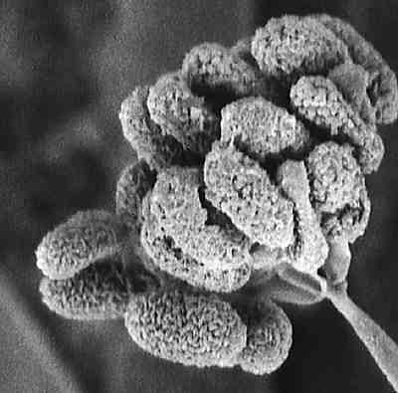
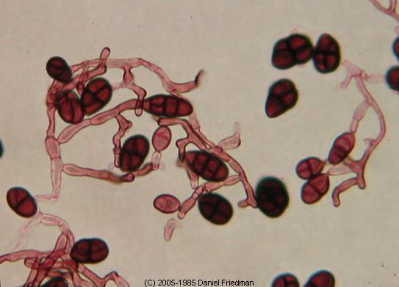
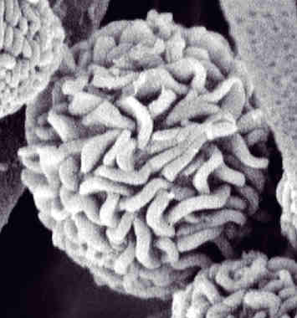
Food Borne Illness
Caused by eating contaminated foods
  For bacteria growth
    warmth, moisture, and food are needed
Can not be detected from appearance or smell.

Slide 6
Botulism: bottles & babies
Source
  Improperly canned foods
  Honey—never give honey to a baby under 1 years old
Symptoms
  Affects nervous system
  Double vision
  Not able to speak or swallow
  Babies: weak cry, floppy movements, constipation
Prevention:
  Don’t use bulging cans
  Don’t feed babies honey

Slide 7

E-Coli
Sources
  Undercooked ground beef
  Un-pasteurized milk & juice
  Fecal matter & infected soil
  Fruits & Vegetables
Symptoms
  Cramps
  Diarrhea
  Nausea
  Vomiting
  Fever
Prevention:
Make sure meat is properly cooked
Wash your hands!

Slide 8
Hepatitis A
Source
  Fecal matter
  Improper hand
  washing
Symptoms
  Fever
  Loss of appetite
  Nausea, Vomiting
  Jaundice
Prevention:
Wash your hands!

Slide 9
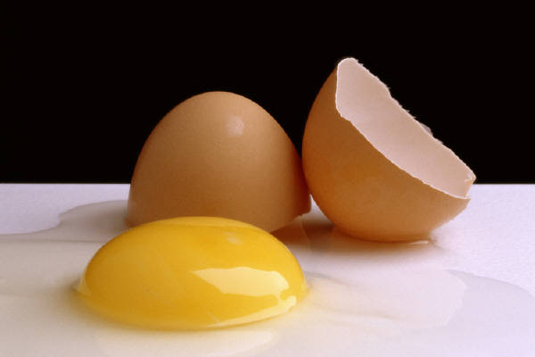
Salmonella
Source
  Fresh poultry
  Raw eggs
Symptoms
  Cramps
  Diarrhea
  Nausea
  Chills
  Fever
  Headache

Slide 10
Staphylococcus
Source
  Human skin, nose & throat; passed by not washing hands
Symptoms
  Nausea
  Vomiting
  Diarrhea
  **Similar to a nasty flu or cold

Slide 11
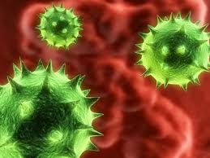
Norovirus
Source
  Raw/undercooked oysters
  Raw produce
  Contaminated water
  Foods that aren’t reheated after contact with norovirus
Symptoms
  Nausea
  Watery diarrhea
  Stomach cramps
Prevention:
  Stay hydrated!

Slide 12
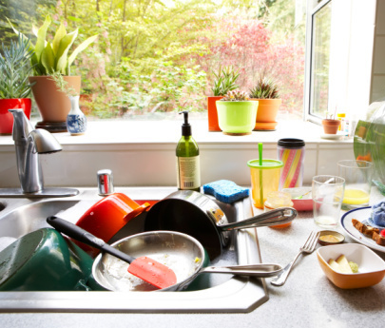
Clostridium Perfringens
“The food service germ”
Source
  Meat products: stews, casseroles & gravy
  Food left out on counter
Symptoms
  Abdominal pain
  Cramps
  Diarrhea
Prevention:
  Cook meats thoroughly
  Reheat foods properly

Slide 13
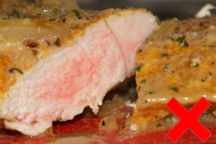
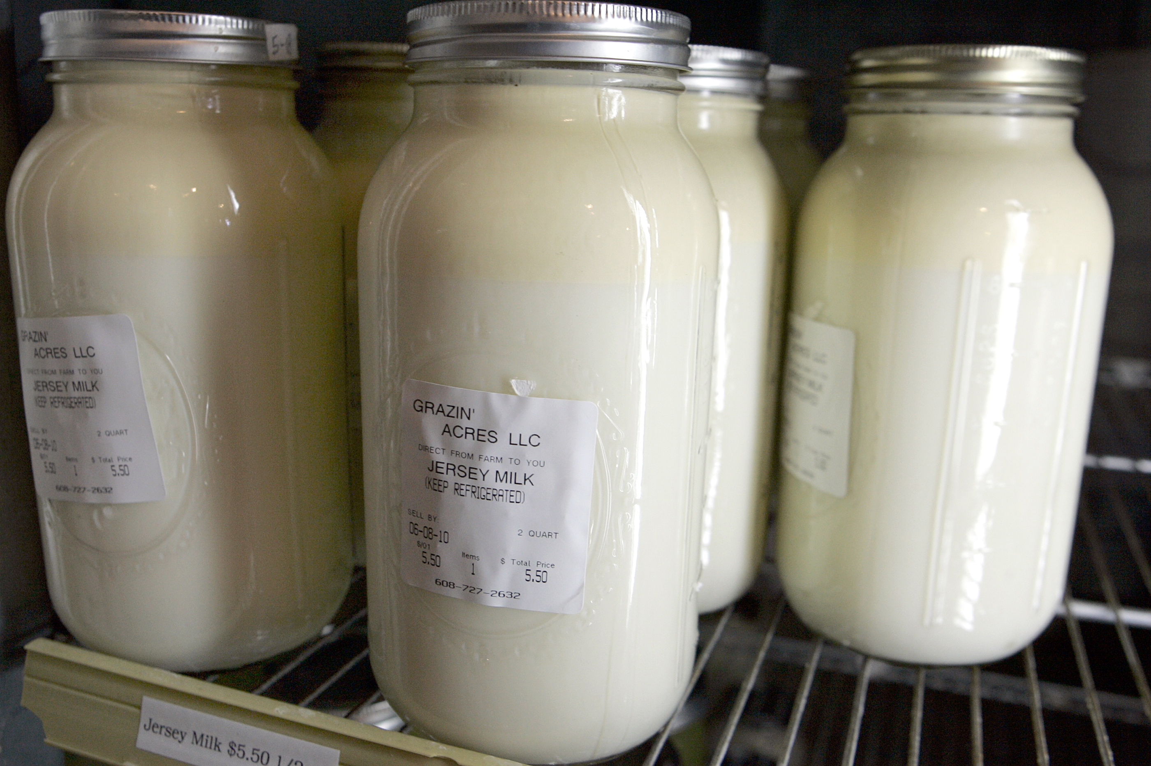
Campylobacter SSP
Source
  Raw and undercooked poultry
  Unpasteurized milk
  Contaminated water
Symptoms
  Upset stomach
Prevention
  Use a thermometer!
  Be careful of water sources

Slide 14
Food Borne Illness Statistics
The CDC estimates that food borne illnesses cause:
  approximately 76 million illnesses
  325,000 hospitalizations
  5,000 deaths in the United States each year

Slide 15
YOPI’s
Young, Old, Pregnant & Immune- Compromised
People that fall into these four categories are most vulnerable to food-borne illness.

Slide 16
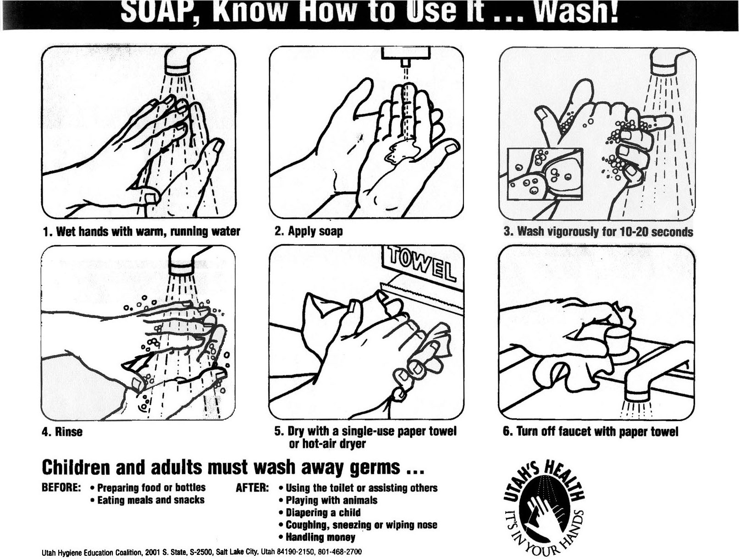
Prevention: Preparation
Wash Hands 20 seconds, hot soapy water

Slide 17
3 Sanitation Tips
Clean and sanitize work surfaces
Wash dishes in hot soapy water
Use plastic or nonporous cutting boards for cutting raw
meats & raw poultry

Slide 18
Cleaning surfaces that touch raw meat, poultry, or eggs:
        Soap
        Hot water
        Bleach spray

Slide 19
Food Safety Video
How clean are you?

Slide 20
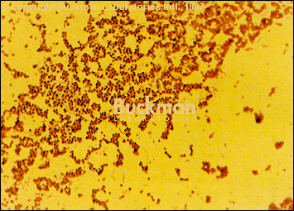
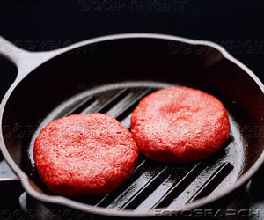
Prevention Preparation: Cont.
Don’t eat pink ground beef
Don’t eat raw eggs (even cookie dough!)
Always wash items after they come in contact with raw meat
Never placed cooked food on plate that held raw meat
Wash fruits and vegetables

Slide 21
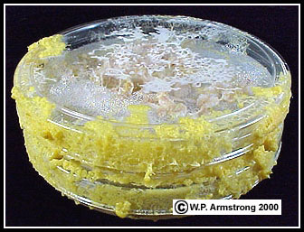
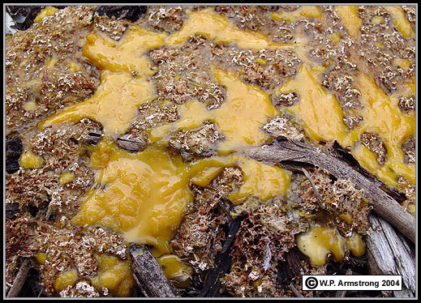

Prevention: Storage
Throw food with off-odor away
Don’t use bulging cans
Store raw meat covered in fridge so it will not contaminate other foods
Keep freezer at 0*
Store foods in fridge

Slide 22
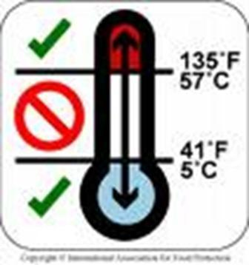
Danger Zone
Temperature range of danger zone:
41°-135°
Bacteria reproduce rapidly
  Freezer stops bacteria growth
  Fridge slows bacteria growth

Slide 23
Thawing Foods
In the fridge (this may take 2-3 days)
In the microwave

Slide 24
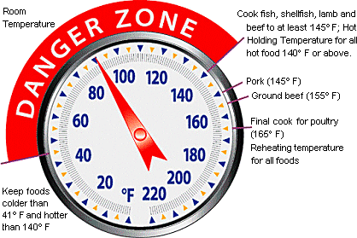
Prevention: Cooling & Reheating
Keep hot foods hot & cold foods cold
Reheat to 165*
Cooling
  Place hot foods in shallow containers
  Foods should not be in danger zone for more than 2 hours (4 hours for restaurants because food is generally refrigerated in a truck)

Slide 25
TCS – What does it stand for?
Temperature Controls for Safety
Many foods require time or temperature controls to prevent food borne illness.

Slide 26
Proper Temperatures
Seafood, beef, lamb, veal, pork (solid pieces): 145 °
Ground meats (beef, lamb, pork): 155 °
All poultry: 165 °
Reheat foods to 165 °
Freezer temperature:0 °
Cold storage of foods: 40 °or below

Slide 27
Dishwashing: The Rules
Scrape off any food into the garbage
Rinse off the dishes
Fill one side of sink with Hot Soapy water
Wash dishes in hot soapy water
Rinse dishes on the other side of the sink
Dry promptly and put dishes away

Slide 28
Dishwashing: The Proper Order
Things that touched the mouth should go first: Glasses, then silverware
Plates, bowls, salad plates, etc…
Mixing tools: bowls, whisks, cooking utensils
Pots and pans
Cookie sheets, dishpans, things with lots of grease or caked-on gunk
Any cutting boards that touched raw meat or poultry

Slide 29
Dishwashing: The Rules
WASH KNIVES SEPARATELY!!

