Slide 1
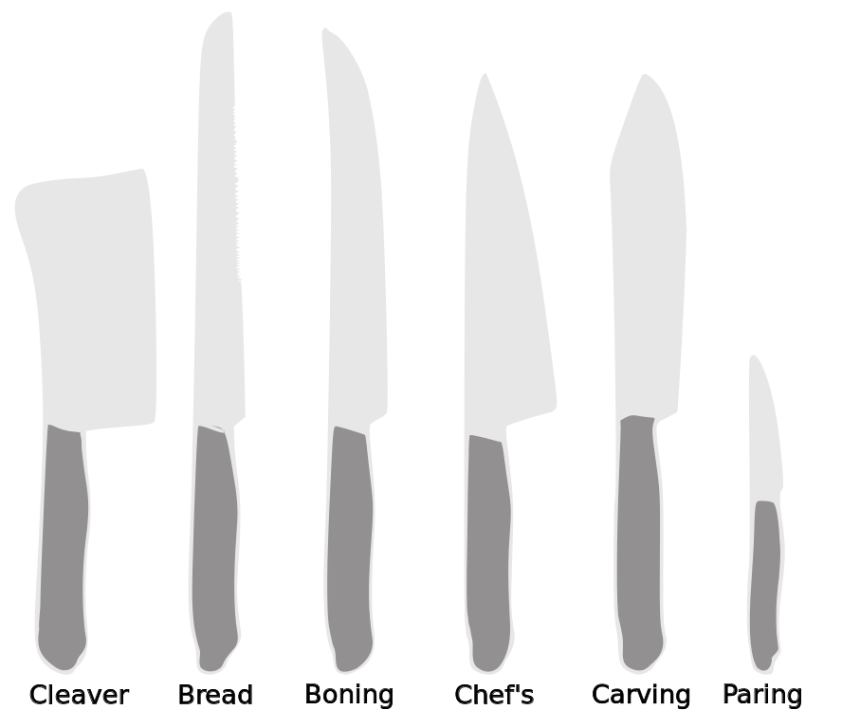
Knives
Foods II

Slide 2
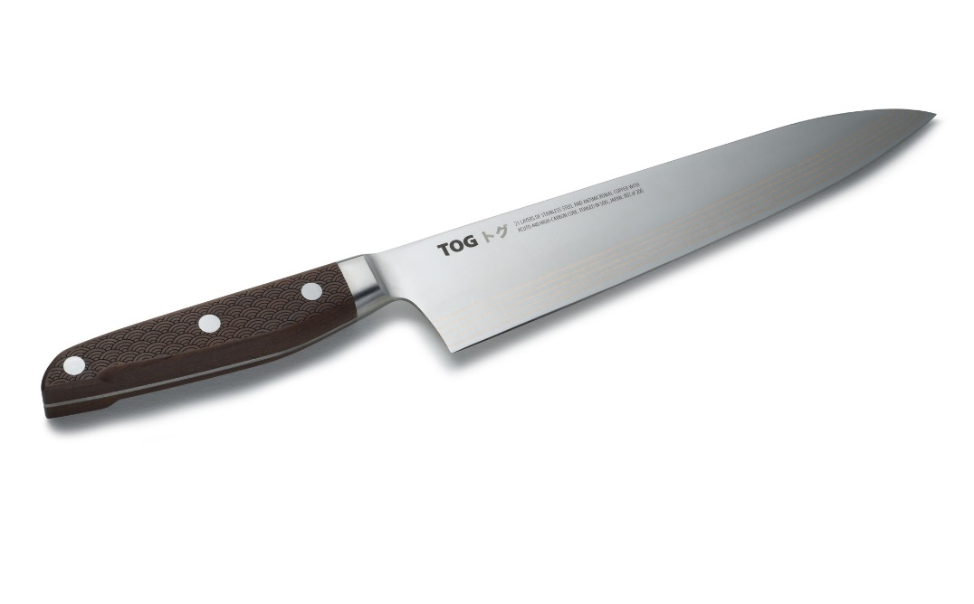
Types of Knives and Their Uses
Chef’s knives: A chef’s knife has a strong rigid blade which makes it suitable for a wide range of jobs. Uses include: dicing, chopping and trimming vegetables, meat and poultry, and chopping fresh herbs

Slide 3
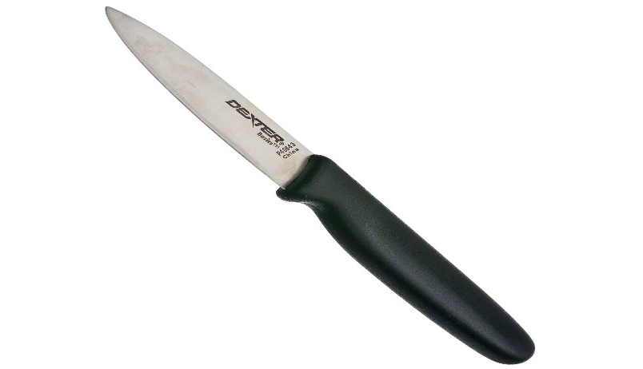
Types of Knives and Their Uses
Paring knife: A paring knife is a small short-bladed knife. Uses include: cutting small items and/or softer items

Slide 4
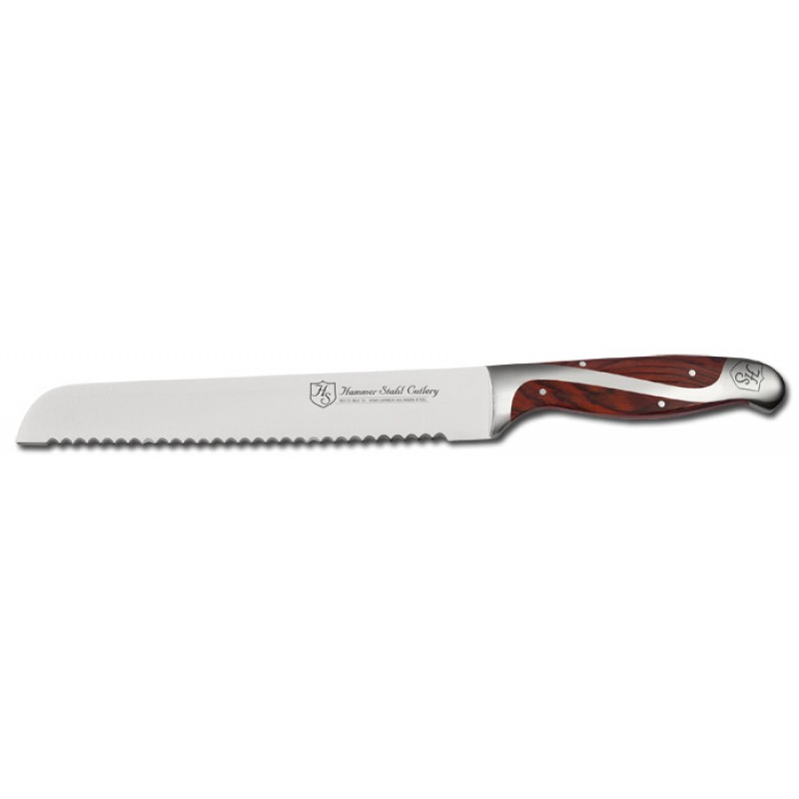
Types of Knives and Their Uses
Bread/serrated knife: Serrated blades have a row of sharp teeth, like the edge of a saw. Uses include: slicing loaves of bread and tomatoes

Slide 5
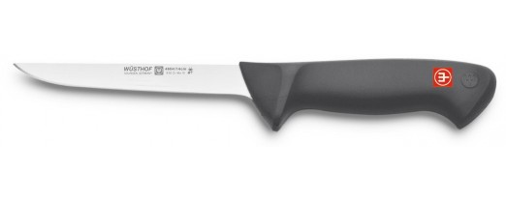
Types of Knives and Their Uses
Boning Knife: used to remove bones from meat joints and poultry. Strong, flexible blade.

Slide 6
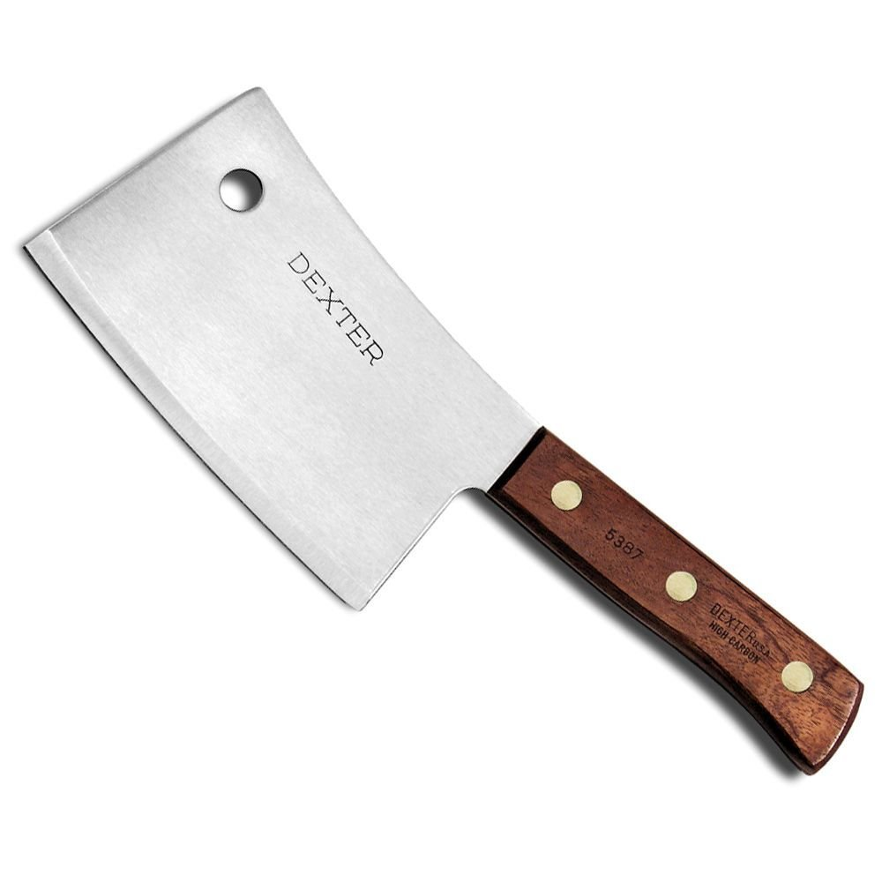
Types of Knives and Their Uses
Cleaver: Heavy, broad blade used for cutting meats

Slide 7
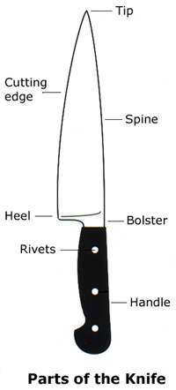
Parts of a Knife
TIP: The tip, which includes the point, is best used for cutting small and/or delicate foods
EDGE: Working part of the blade, from point to heel
SPINE: Top of the blade directly opposite the edge
HEEL: Rear part of the edge. Cuts through large or tough foods when weight and force are needed.

Slide 8
Parts of a Knife
TANG: Part of the blade extending into the handle. Not all knives have tangs and some do not have visible tangs
Bolster: Thick band of steel
Handle: part of the knife that creates its grip
RIVETS: Used to hold the handle pieces and tang together

Slide 9
Knife Safety

Slide 10
Knife Safety
Keep knives sharp!
Never use a dull knife—they slip easily and are more likely to cause injury.
Never use a knife to open anything!
Never try to catch a falling knife
Jump back
Get out of the way
Watch your feet
Never hold food in your hand while cutting
Use a stabilized cutting board

Slide 11
Knife Safety
Follow proper procedures for washing knives.
Never put a knife through the dishwasher
Never put a knife in a sink unattended, regardless of whether its filled with water or not
Never put a knife in a pile of dishes
Dirty knives can spread harmful bacteria
Always sanitize your knife and cutting board when changing tasks.
Keep your knife and area clean from debris (trash or not).
Debris can get caught under your knife and cause your knife to slip.

Slide 12
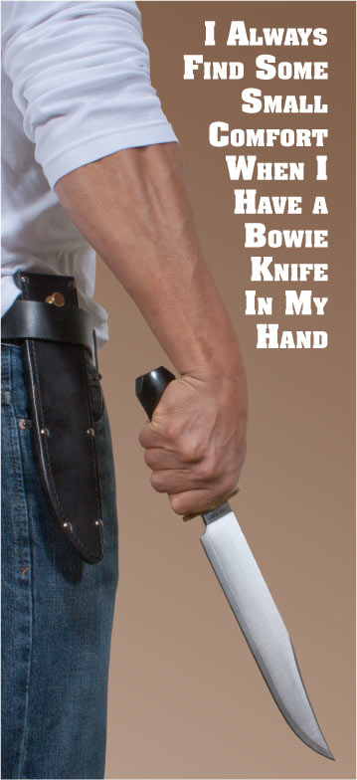
Knife Safety
If you carry a knife…
Carry it close to but not against your body.
The tip should always be facing down.
The blade should always be facing backwards.

Slide 13
Cutting Board Safety
Always place several wet paper towels, damp clean towel, or a rubber mat under the cutting board to prevent it from moving.
Never carry knives on cutting boards
This is often done when carrying dirty boards and knives to the sink and is dangerous.
Always concentrate and focus on what you are doing
Don’t let others distract you

Slide 14
Mise En Place
French for “everything in its place”
The process of preparing your work area and ingredients for a recipe or menu
This includes setting up your station and the placement of your tools.
Place all the tools you will need on a towel to one side of your cutting board
Prepare for trash by having a bowl or other container to the other side of your cutting board

Slide 15
Knife Cuts

Slide 16
Knife Cuts
Keep your fingers turned under and away from the blade when cutting (“claw grip”)
Use the knuckles of your fingers to keep your knife from cutting you

Slide 17
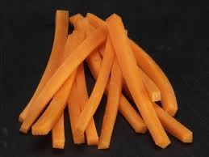
Julienne: matchstick
1/8” x 1/8”
1-2 inches long

Slide 18
Julienne Video

Slide 19
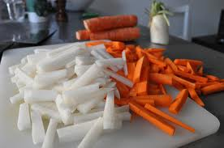
Batonnet
“little stick”
¼ x ¼”
2 inches long

Slide 20
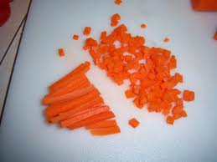
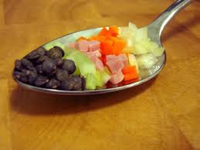
Brunoise
1/8 x 1/8 x 1/8 cube
Made from Julienne cut

Slide 21
Brunoise Video

Slide 22
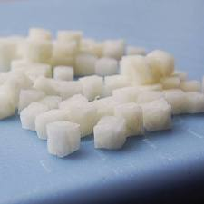
Small Dice
¼ x ¼ x ¼” cube made from Batonnet

Slide 23
Small Dice Video

Slide 24
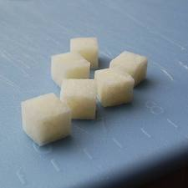
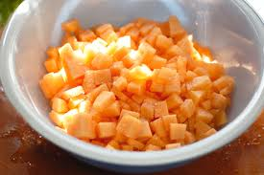
Medium Dice
½ inch cube

Slide 25
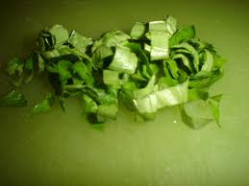
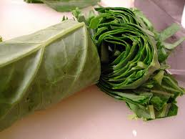
Chiffonade
Easily damaged leaves
Basil, Spinach

Slide 26
Chiffonade Video

Slide 27
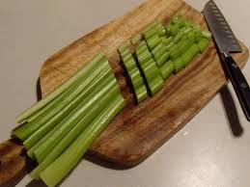
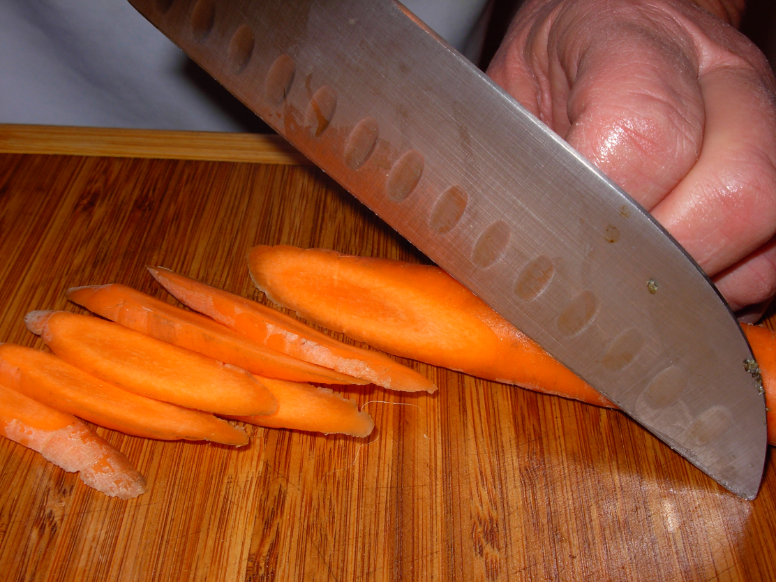
Diagonal
Knife held at an angle to the item being cut

Slide 28
Diagonal Cuts Video

Slide 29
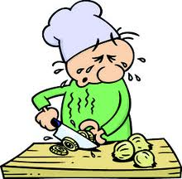
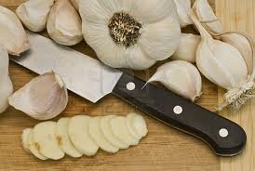
Cutting Garlic & Onions
ONION
GARLIC

Slide 30
Onion Video, Garlic Video

