Slide 1
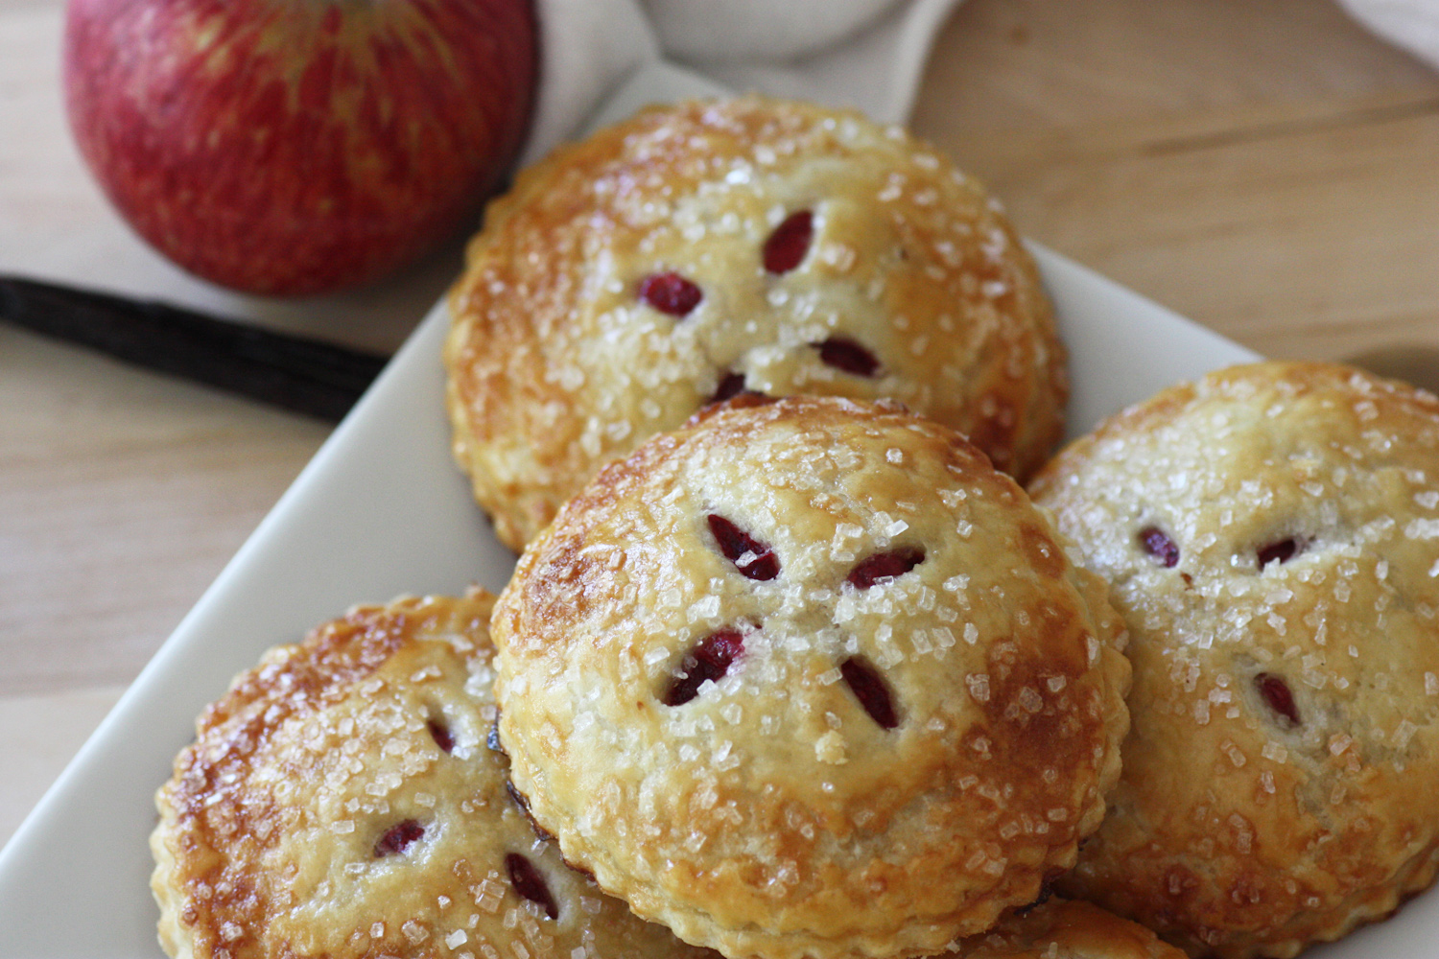
Pies and Pastries

Slide 2
Ingredients
Flour
Provides structure. Excess gluten can cause toughness!
Fat
Moistness, tenderness, smooth mouth feel, flavor
Salt
Flavor and sweetness
Water
Moisture to help gluten form. Steam leads to flakiness!

Slide 3
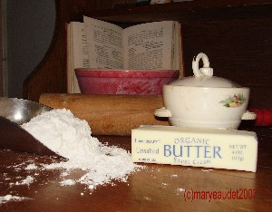
Pastry Dough Ingredients
Differences in fats:
Lard and shortening = most common
Different fat = different taste and flavor
Lard or Shortening = more tender
Oil = harder to handle i.e. crumbly
Differences in flours:
All-purpose – harder wheat, more gluten
Cake flour – softer wheat, less gluten

Slide 4
Preparation:
1. Add all dry ingredients
2. Cut in the fat
3. Add the liquid
4. Cook!

Slide 5
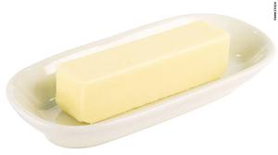
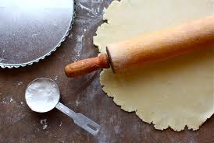
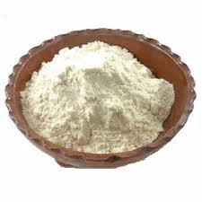
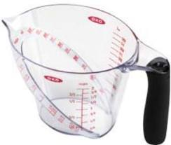
Reasons for Toughness
too much flour
too much liquid
too little fat
too much handling

Slide 6
To Create Tenderness:
DON’T:
overmix the dough when adding the liquid
use the rolling pin too vigorously when rolling the pastry
stretch the pastry when fitting it into the pie plate
DO:
handle dough as little as possible

Slide 7
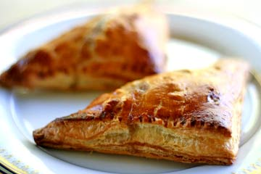
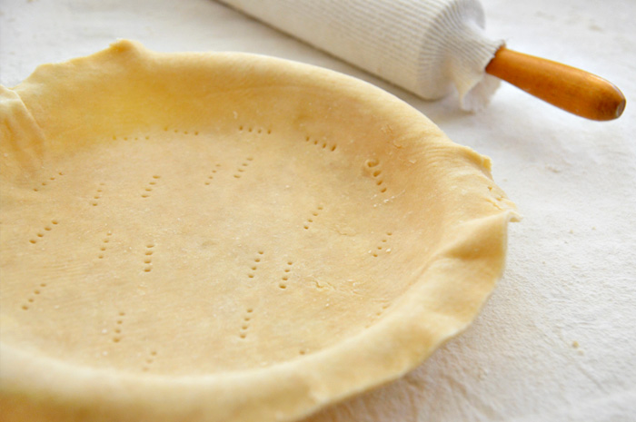
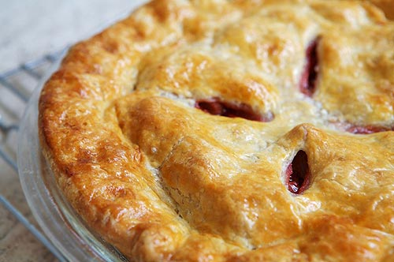
Pie Shell
Single
Double

Slide 8
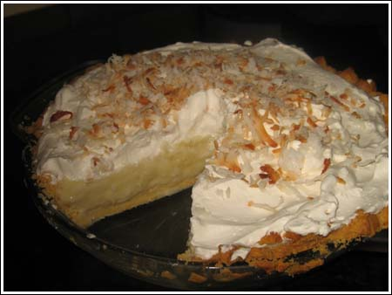
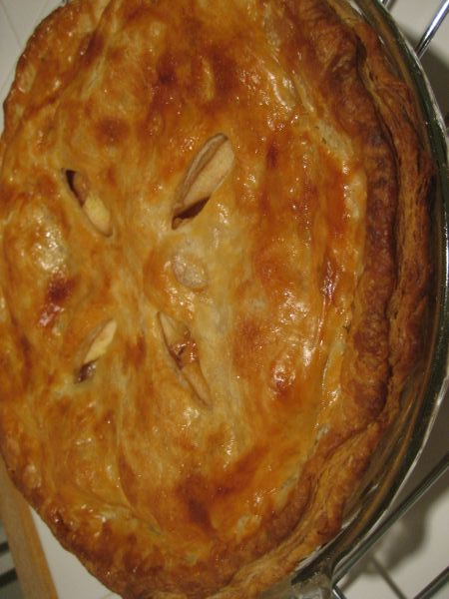
Three Styles of Pie Crusts
Pie shell
baked separately and filled later
pricked crust
Filled with creams/pudding
Single crust pie
bottom crust and filling baked together
Ex: pecan and pumpkin
Double crust pie
bottom crust, filling, and top crust baked together
Ex: fruit pies

Slide 9
Storage of Pies
Cream/ Custard Pies
Refrigerate!
Savory Pies
Refrigerate!
Fruit Pies
Best within 1-2 days, okay up to 4 days
Can freeze after baking

