Slide 1
Harmony
There are 2 types of harmony.
Unity
Variety

Slide 2
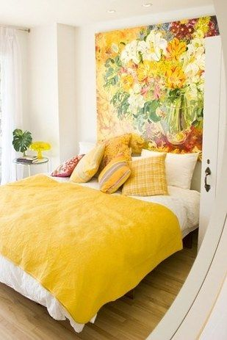
What is creating unity and variety?
UNITY: (Things that are the same)
Color scheme
Style
Size of furnishings
Wood elements
VARIETY: (Things that are different)
All of the accessories and the different prints

Slide 3
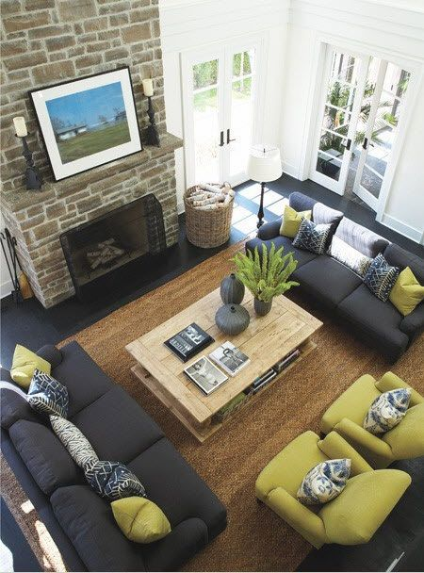
UNITY
Unity occurs when all the parts of a home or room are related by one idea.
A unified design has consistency of style

Slide 4
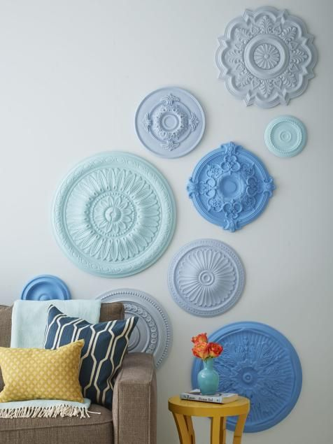
VARIETY
When two or more different elements of design are used to add interest to a design.
Variety can be achieved by incorporating items outside the style or theme. This helps to avoid sameness.

Slide 5
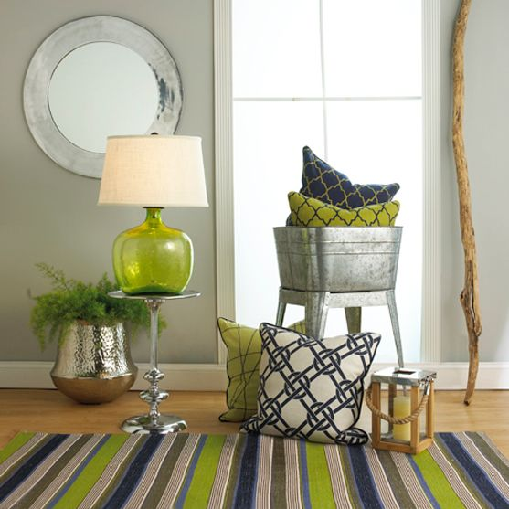
HARMONY
Is achieved when unity and variety are effectively combined.
Carrying variety too far creates confusion.
A lack of unity may make a small home seem even smaller.

Slide 6
Harmony Quilt Block
Pick 3-4 pieces of colored paper to create 2-4 different block designs. Then repeat those designs to fill in the grid provided. This will illustrate Harmony.
Variety in block design and Unity in block colors

