Slide 2
Balance Foldable
Cut on the dashed lines on each side of the paper.
Fold in half the long way (hotdog), so that the printed squares are inside.
Then open the paper and cut on each the lines to the center line to create four flaps.

Slide 3
PRINCIPLES OF DESIGN Balance
Objective: Identify Balance and the three types of balance used in Interior Design.

Slide 4
Balance Foldable
Flap 1: Principle of Design: Balance
Flap 2: Symmetrical Balance
Flap 3: Asymmetrical Balance
Flap 4: Radial Balance

Slide 5
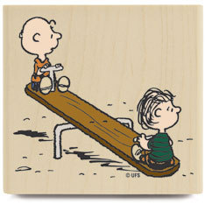
BALANCE
A sense of equilibrium.
When establishing balance consider visual weight created by size, color, texture and number of objects.

Slide 6
TYPES OF BALANCE
SYMMETRICAL
Achieved by placing identical objects on either side of a central point.
ASYMMETRICAL
Achieved by placing different objects of equal visual weight on either side of a central point.

Slide 7
SYMMETRICAL BALANCE
Creates a quiet, restful feeling.
Suggests restraint, orderliness, formality.
Also called, FORMAL balance.

Slide 8
Symmetrical Balance
What are the asymmetrical elements in this room?

Slide 9
Symmetrical Balance
Where?
Two beds with identical bedding.
The lamps and night stands.
The seats at the end
of the bed.
Windows

Slide 10
Symmetrical Balance
Where?

Slide 11
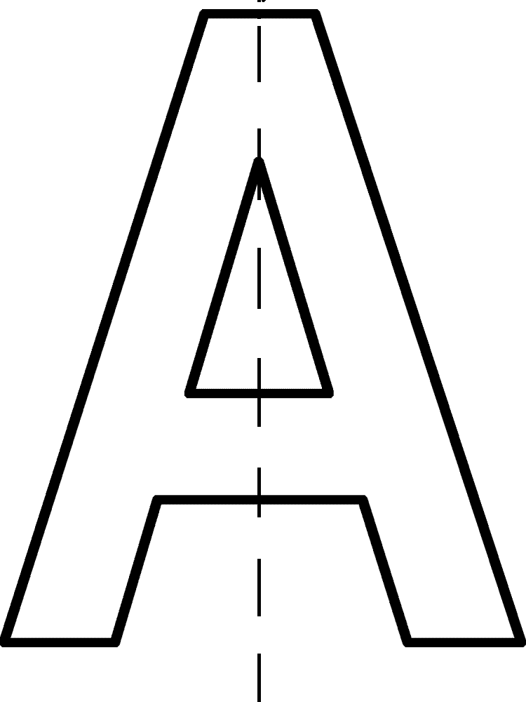

Slide 13
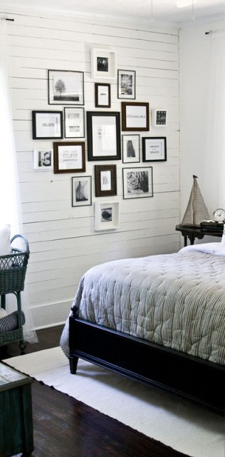
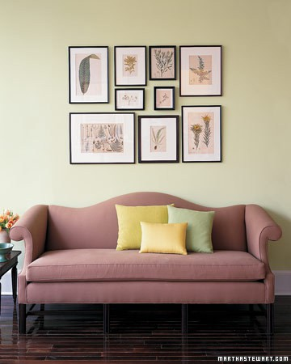
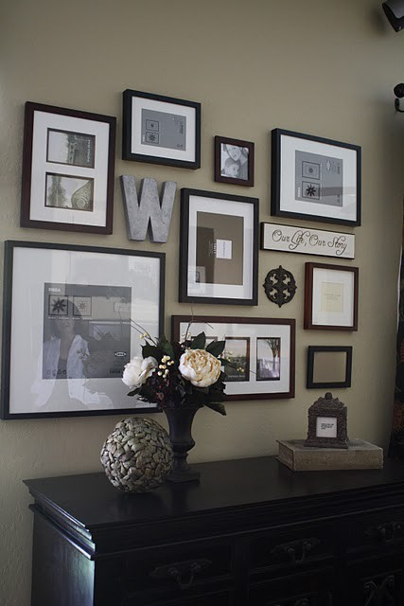
Asymmetrical Balance
Creates more interesting arrangements.
Suggests informality, relaxed.
Also referred to as INFORMAL balance.

Slide 14
Asymmetrical Balance
Mirror is placed off center on the mantle.
Tray and bottles on either side of the mirror help to balance it out.

Slide 15
Asymmetrical Balance
The faux animal head
The plant the bowl
And the lamp all work together to create a sense of balance.

Slide 20
Asymmetrical Balance
The star and
Pumpkin work with
The candles on the
Other side to create a sense of balance.
*visual balance.

Slide 21
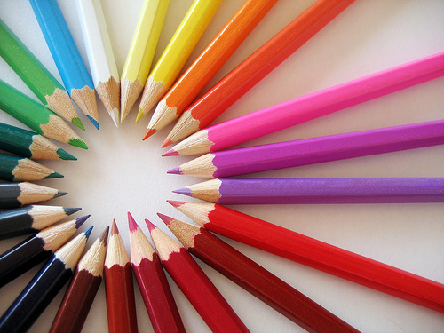
Radial Balance
Radial Balance involves having furnishings, accessories or patterns arranged in a circular manner.
Radiation creates a sweeping, dramatic, circular motion in a room.

Slide 22
Radial Balance

Slide 23
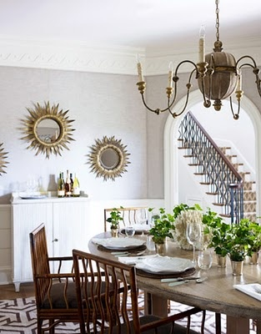
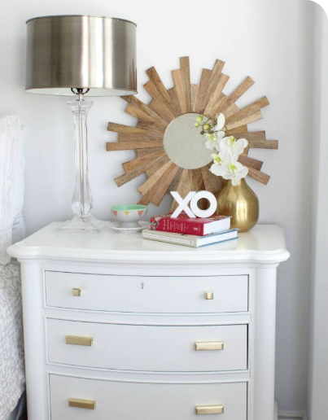
Radial Balance

Slide 24
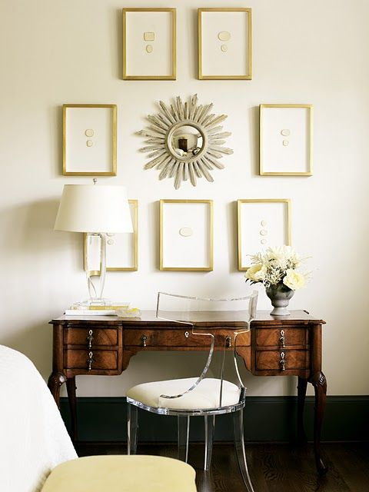

Slide 25
Balance Assignment
Using polyvore.com
Create one example of EACH kind of balance:
Symmetrical
Asymmetrical
Radial
Print them and mount into smash book.
Label them “Symmetrical Balance” and “Asymmetrical Balance.

