Slide 1
Color Wheel & Schemes
The Latest & The Greatest!

Slide 2
What is Color?
The reflection of light

Slide 3
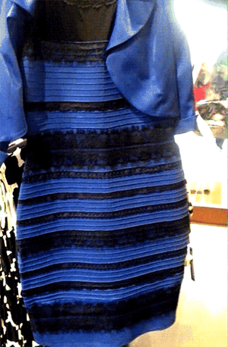
What color is the dress?

Slide 4
What is Color?
The reflection of light
Primary colors: Red, Yellow and Blue
Secondary colors: Made by mixing equal parts of two primary colors. Green, Violet, and Orange
Complimentary colors: Opposite colors on the color wheel. Red/Green, Yellow/Violet, Blue/Orange.
Tertiary colors: Made by mixing a primary and a secondary color. Yellow-green, Blue-green, Blue-violet, Red-violet, Red-orange, & Yellow-orange

Slide 5
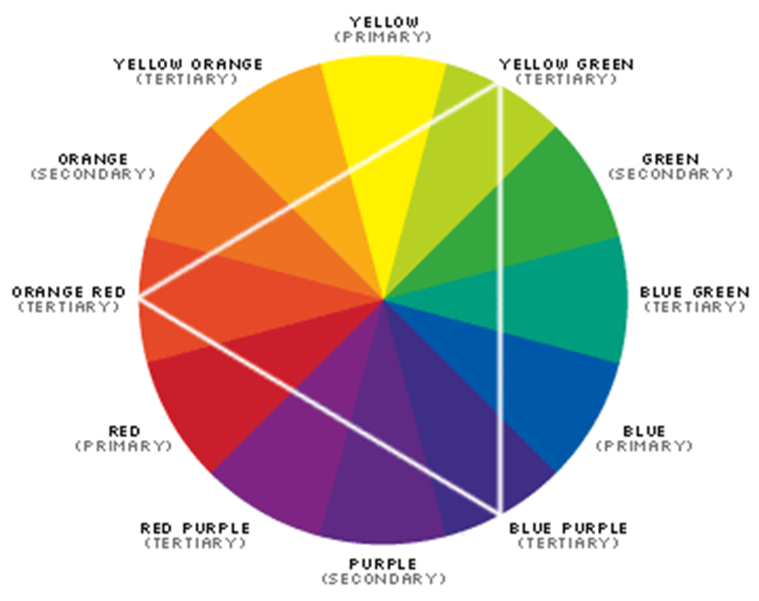
Color Wheel
The color wheel is made up of twelve colors
It is used to organize colors.
To visualize color relationships.
You can identify colors that go well together.
*Using colored pencils color in the colors of the color wheel.

Slide 6
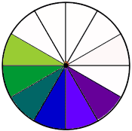
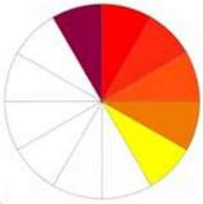
Warm Colors and Cool Colors
Color has temperature and it can effect the way we feel in a room.
Cool Colors recede away from us, make spaces feel larger and create cooler, calming and relaxing spaces.
Warm Colors advance towards us, make spaces feel cozier, create feelings of warmth, activity and excitement.
The color used in a room can change the psychological temperature in a room up to 5 degrees.

Slide 7
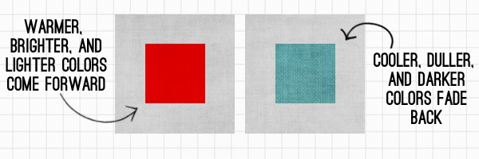
For Example…

Slide 8
Create a Color Wheel.
Using the color wheel provided
Label each color around the outside of the color wheel.
Then mix the primary colors to create each of the secondary and tertiary colors.
Paint each of the colors in the appropriate space.
Allow it to dry

Slide 9
Color Schemes

Slide 10
Tints
Created when you add white to a color

Slide 11
Shades
Created when you add black to a color

Slide 12
Tones
When you add grey to a color

Slide 13
Monochromatic
Uses tints and shades of a single hue.
The main tint or shade should be easy to live with, and can be accented by more intense shades.

Slide 14
Monochromatic

Slide 15
Monochromatic

Slide 16
Neutral
A color scheme that uses browns, blacks, creams or metallic colors.
Neutral color schemes can be easier to live with than with vibrant color schemes.
To make this scheme look best, use a variety of textures and shapes to add interest.
These colors are NOT on the color wheel

Slide 17
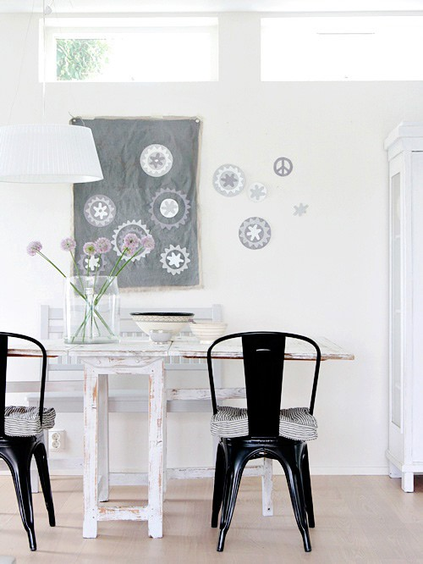
Neutral

Slide 18
Neutral

Slide 19
Accented Neutral
A neutral color scheme with one accent color for interest and variety.

Slide 20
Accented Neutral

Slide 21
Accented Neutral

Slide 22
Accented Neutral

Slide 23
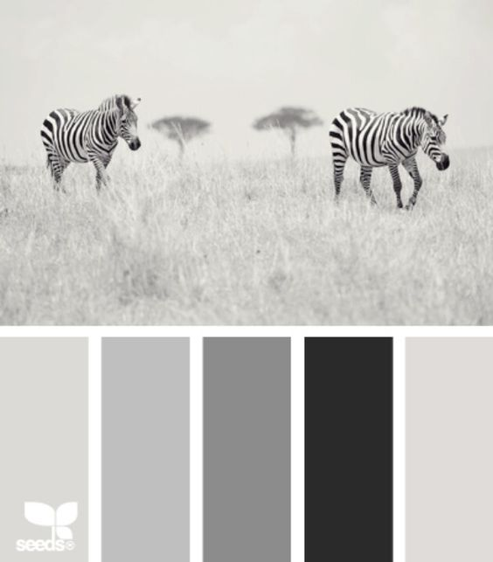
Achromatic
A color scheme using black, white, and/or gray
AKA: colors NOT on the color wheel

Slide 24
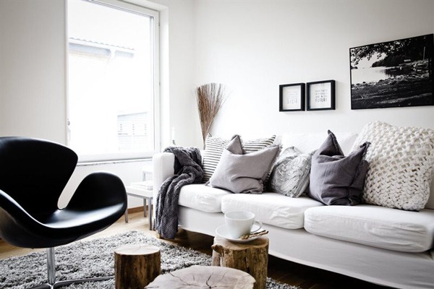
Achromatic

Slide 25
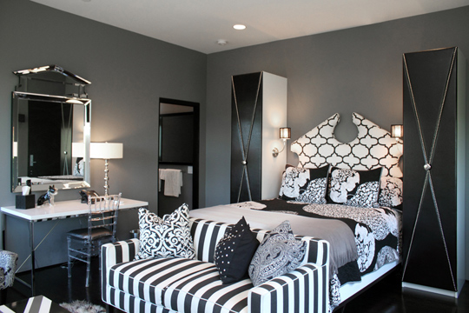
Achromatic

Slide 26
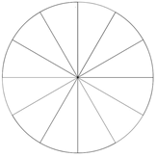
Analogous
Uses 3-5 hues that are next to each other on the color wheel.

Slide 27
Analogous

Slide 28
Analogous

Slide 29
Complimentary
Use hues that are opposite each other on the color wheel
Tends to be a lively color scheme
Use similar values and intensities when combining complementary hues
Has one dominant hue and one accent hue.

Slide 30
Complimentary

Slide 31
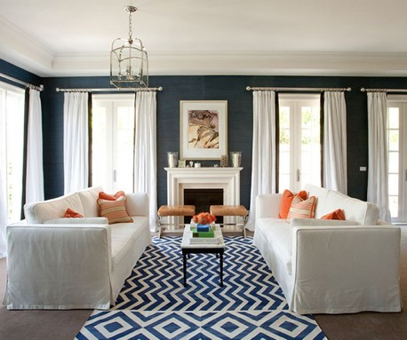
Complimentary

Slide 32
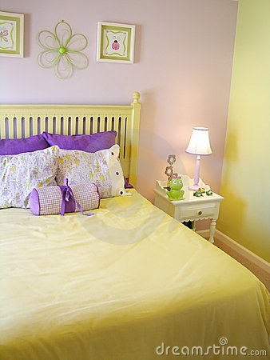
Complimentary

Slide 33
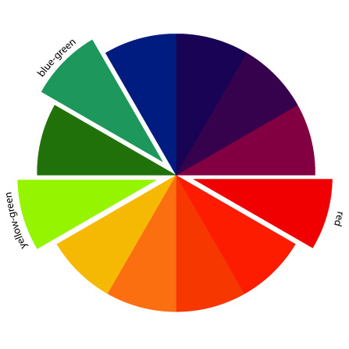
Split –Complementary
Uses a primary color and the two intermediate colors on either side of its complement.
Often found in floral prints or plaids.
Creates strong contrasts in colors

Slide 34
Split Complement
The primary color yellow with accents of blue-violet and red violet in the flower arrangement on the table.

Slide 35
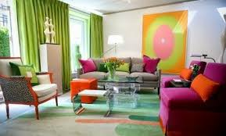
Split-Complementary

Slide 36
Split Complement
The secondary hue, violet combined with yellow-green and yellow-orange.

Slide 37
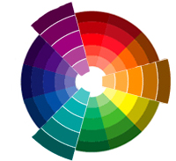
Triad
Use three colors evenly spaced on the color wheel.
Usually uses either the primary or secondary colors
Uses a dominant hue, with others for accent

Slide 38
Triad

Slide 39
Triad

Slide 40
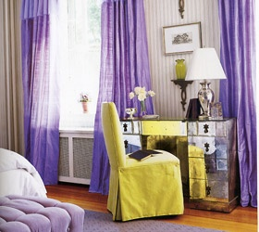
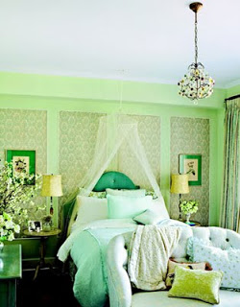
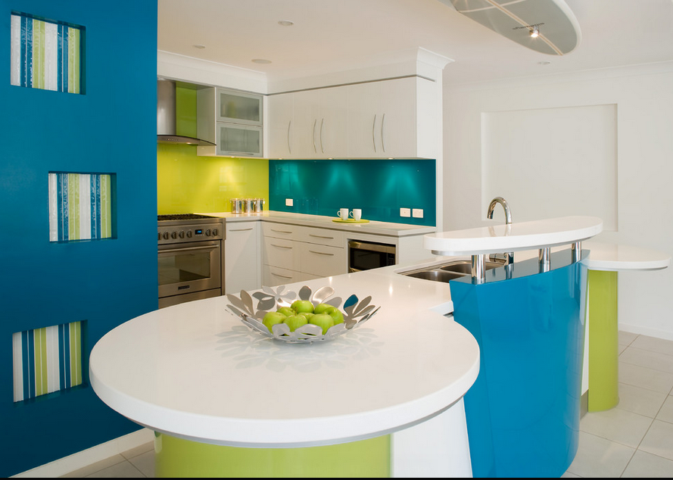
What Color Scheme?
2.
1.
3.
Notes:
Monochromatic
Complimentary
Analogous

Slide 41
Color scheme identification wheel
Cut out your circle
Use a brad to attach it to the center of your color wheel. Then glue only the outside of the circle into your notebook. The color scheme wheel should still move when it is glued into the notebook.
1
9
5
8
6
7

Slide 42
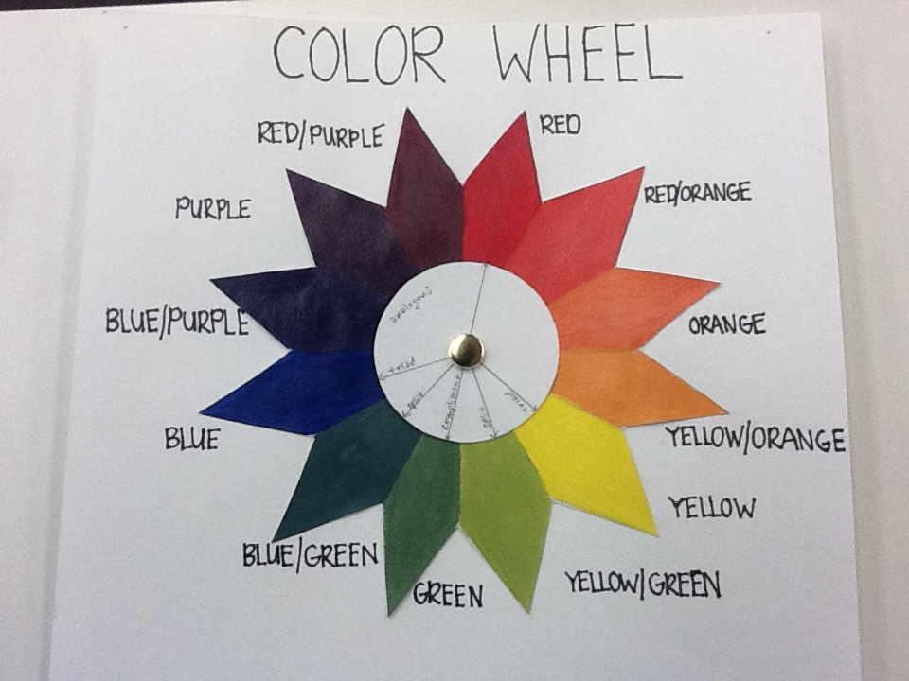

Slide 43
Let’s Review!
Value – the lightness or darkness of a hue created by adding black or white.
Shades – created by adding black to a color
Tints/pastels – created by adding white
Intensity – the brightness or dullness of a hue created by adding its compliment. Bold & intense colors should be used sparingly or as accents.
Tone – created when you add the hue’s complement or gray

Slide 44
Color Scheme Picture Assignment

