Slide 1
Structural and Decorative Design

Slide 2
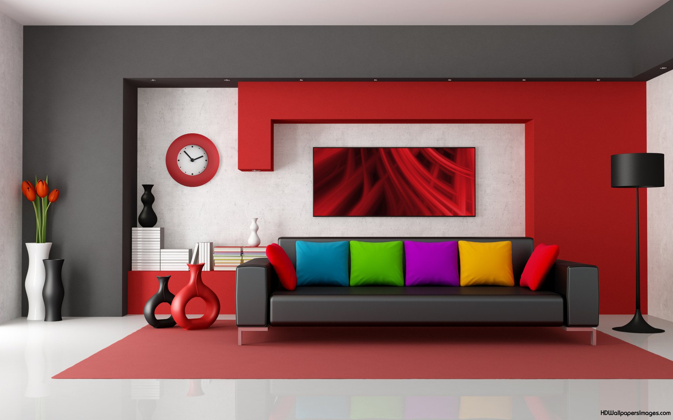
Design
Is the selecting and organizing of materials to fill a function.

Slide 3
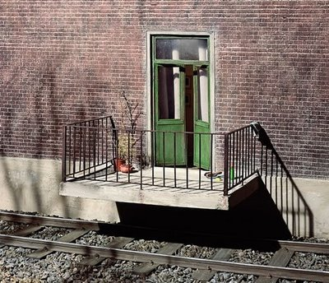
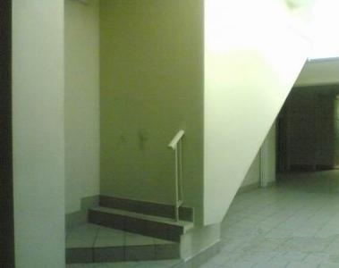
Function
What purpose will the object serve?

Slide 4
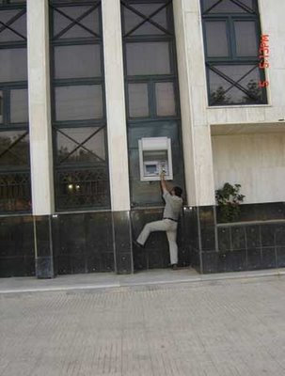

Slide 5
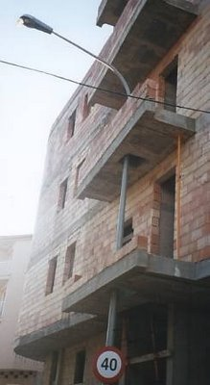
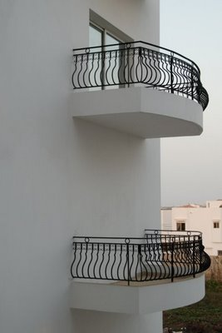

Slide 8
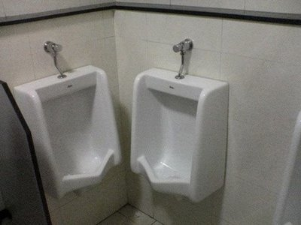

Slide 9
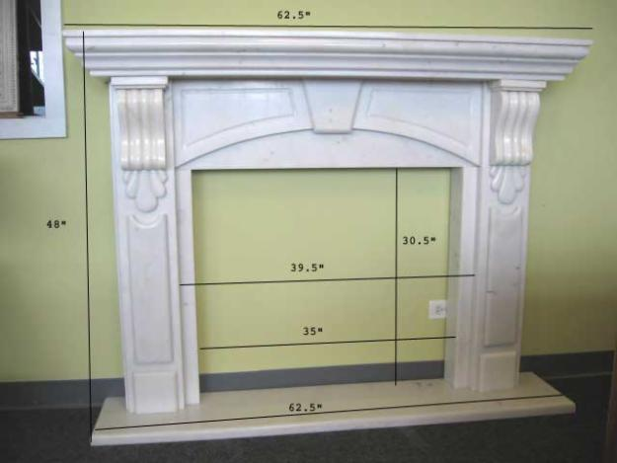

Slide 10
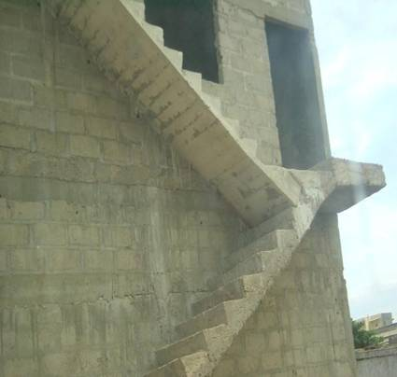

Slide 11
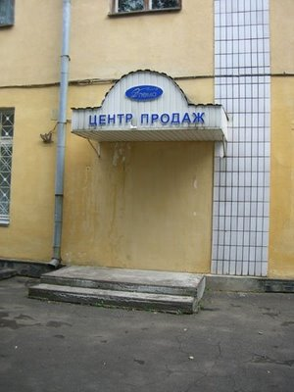

Slide 12
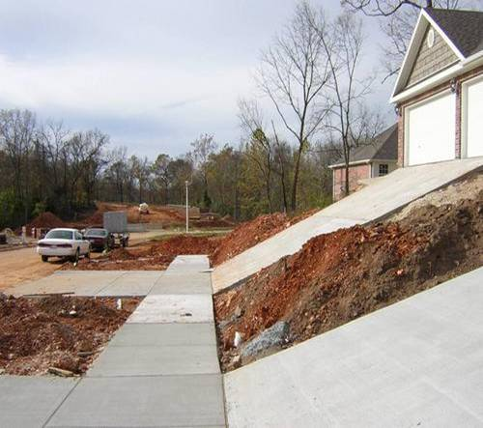

Slide 13
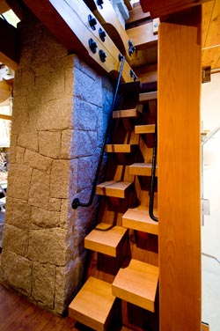
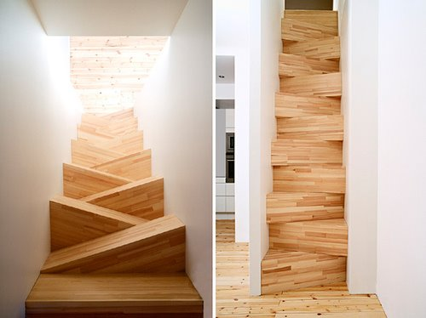

Slide 14
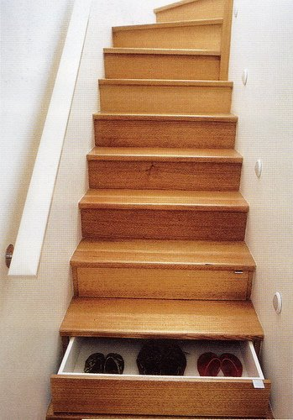

Slide 15
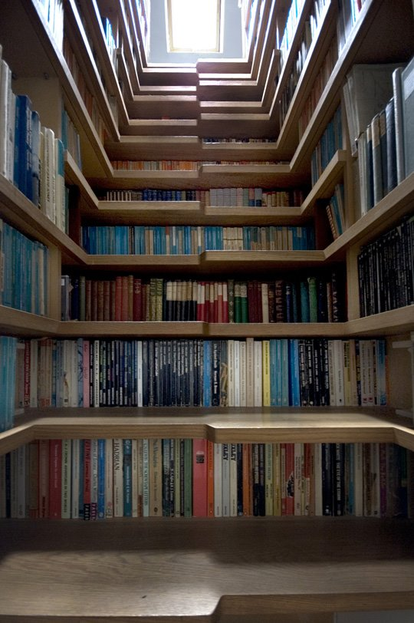
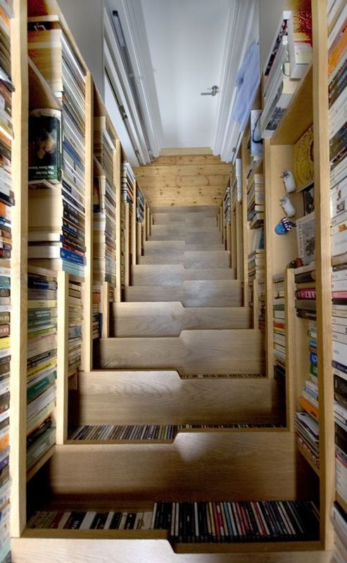

Slide 16
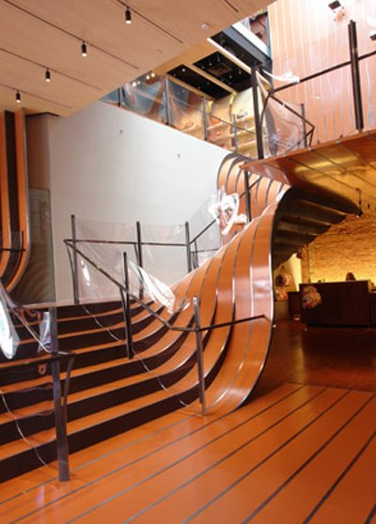
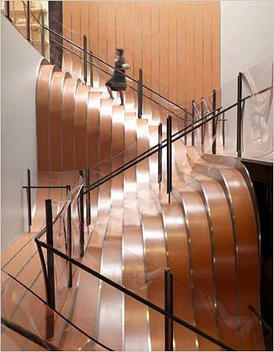

Slide 17
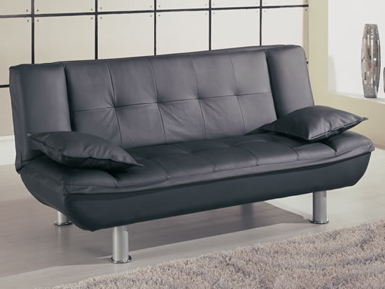
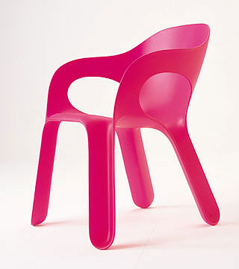
Materials
What will the object be made of?

Slide 18
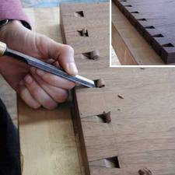
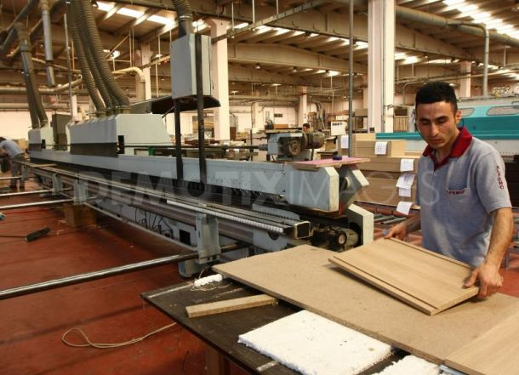
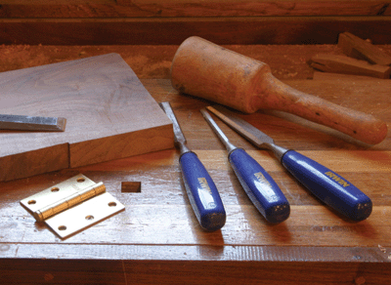
Technology
How will the object be made?

Slide 19
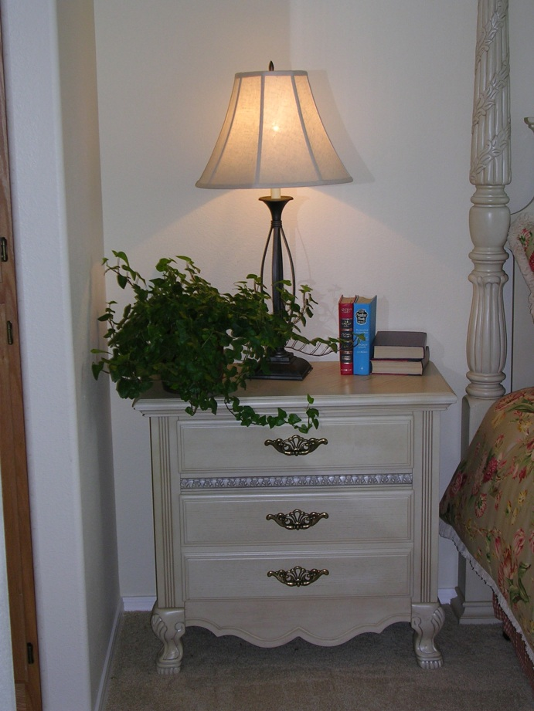
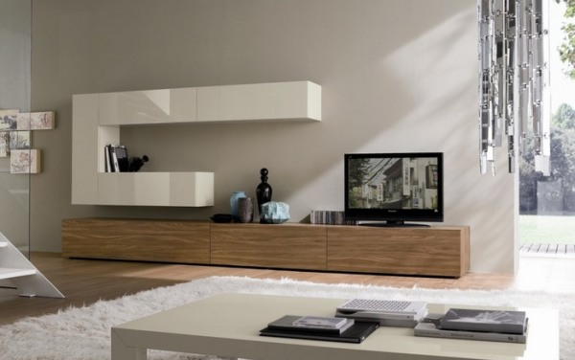
Style
Is the object appropriate and appealing to the user?

Slide 20
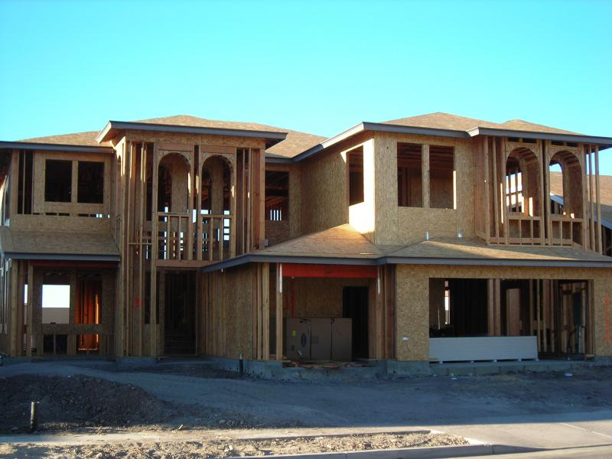
Structural design is:
The design is an integral part of the structure itself.
The structure and the design cannot be separated.
The simplest form of design

Slide 21
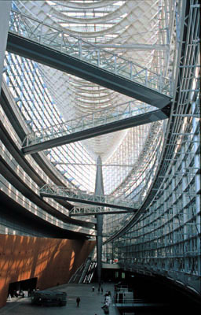

Slide 22
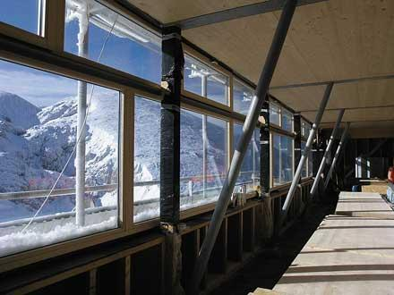

Slide 23
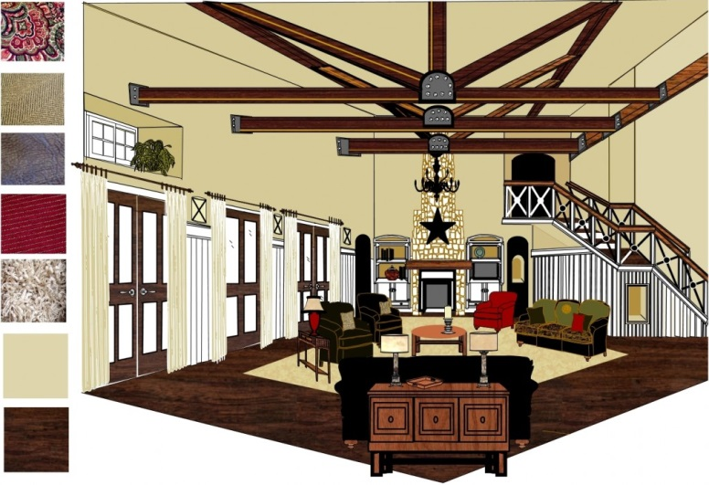
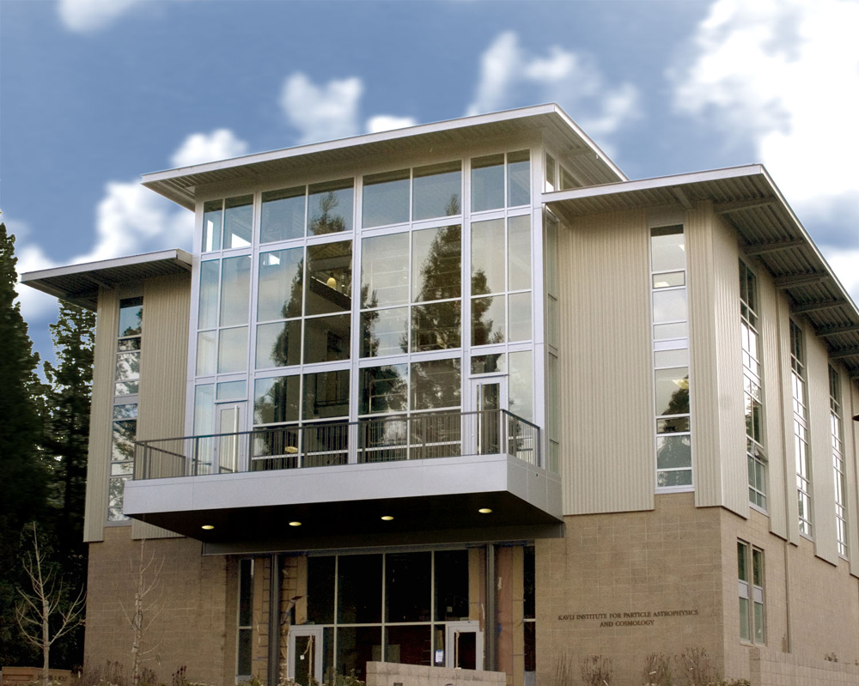
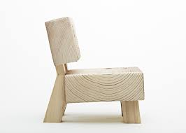
Structural Design

Slide 24
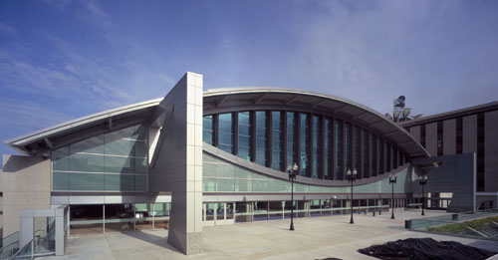

Slide 25
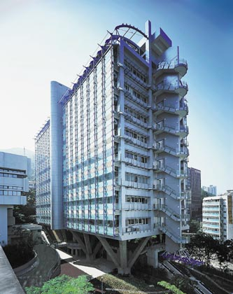

Slide 26
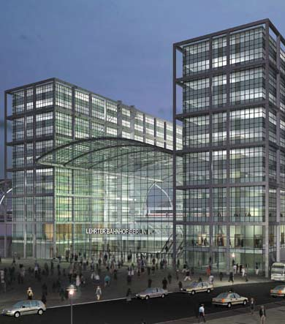

Slide 27
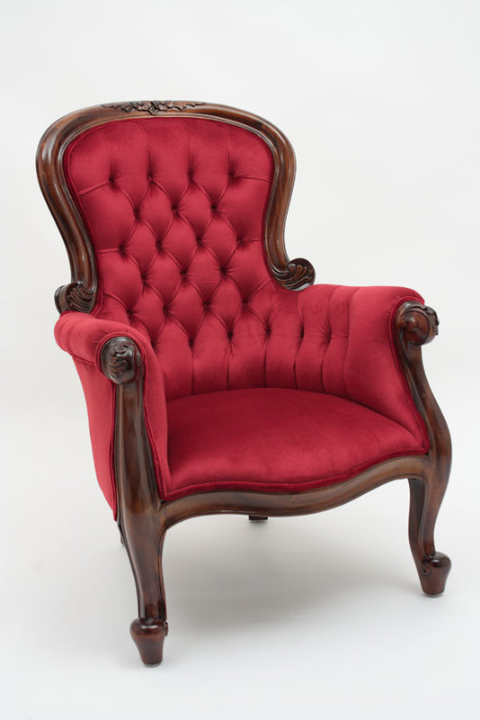
Decorative Design is:
Involves the application of color, line, texture, or pattern to an object
Ornamentation added to the basic form.
“Extra fluff”

Slide 28
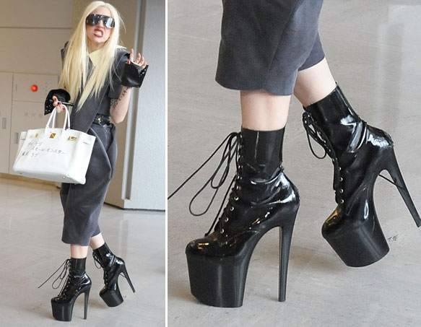
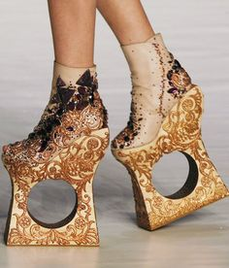
Guidelines for decorative design
Ornamentation should be suitable for the intended use of the item.
The object should be useable and functional.

Slide 29
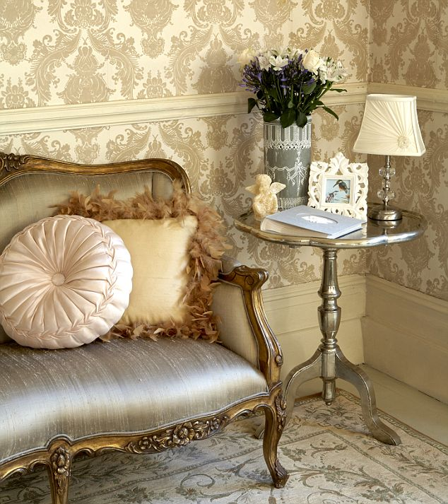
Guidelines for decorative design
Embellishment should emphasize structural points.
Decoration should be appropriate in size and amount to the object on which it is found.

Slide 30
Four types of decorative design
Naturalistic: reproductions of natural subjects.
Stylized: A representation that simplified version of nature.
Abstract: unrecognizable as a specific object or thing.
Geometric: a design made with the use of Stripes, Plaid and geometric shapes.
Stylized
Abstract
Naturalistic
Geometric

Slide 31
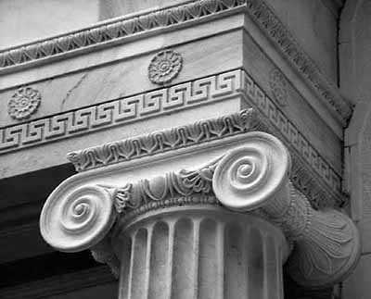

Slide 32
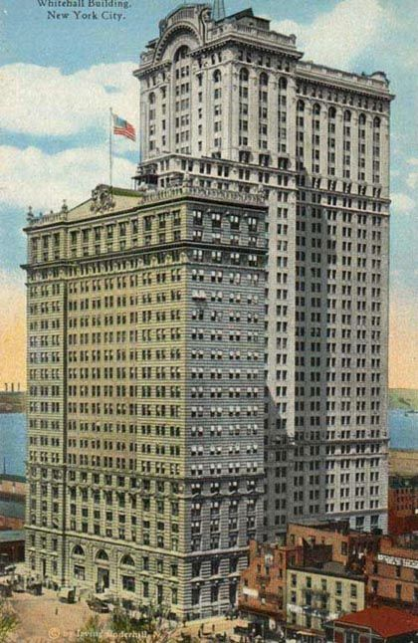

Slide 33
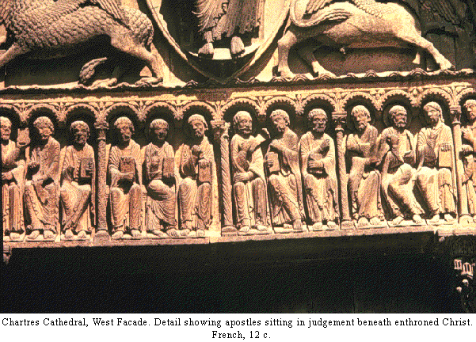

Slide 34
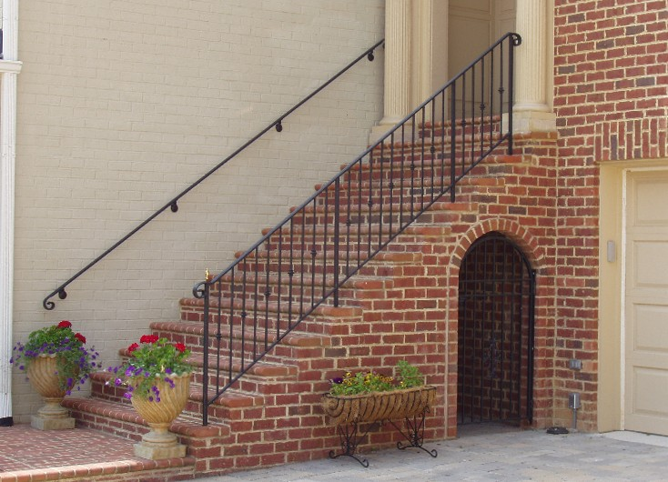

Slide 36
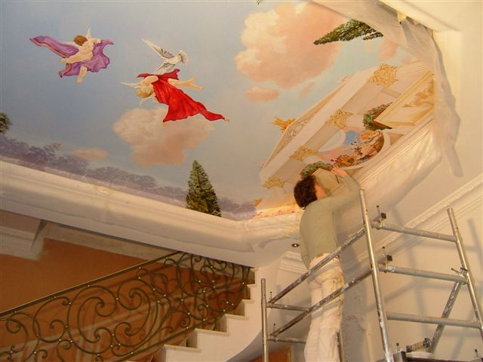

Slide 37
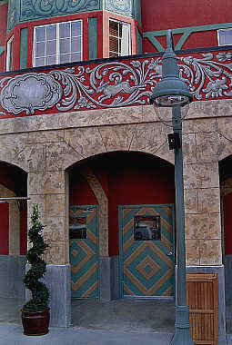

Slide 39
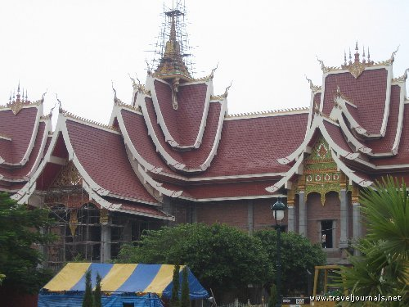

Slide 40
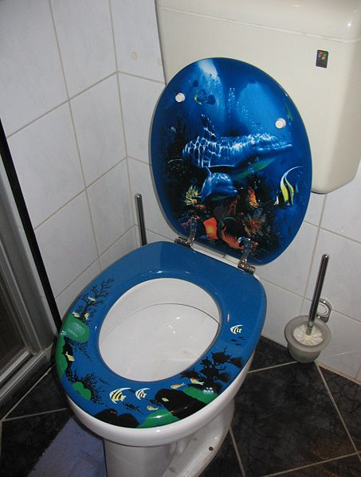

Slide 41
The Rule
The form of an object or space should reflect its intended use and fulfill its intended function.
The first priority in design is it’s function, which dictates the shape or form of a design.
“Form Follows Function”

