Slide 1
Presentation Techniques
Objective 1: Students will demonstrate professional design presentation techniques

Slide 2
Why do we make such a fuss about presentation?
Presentation is the major part of what we are trying to communicate in Interior Design
Ideas
Talent
If its not done well, you could lose a client
Can sell your ideas
BLiNK – packaging example

Slide 3
Techniques of Presentation
INTERIOR PROSPECTIVE: drawings of a room inside a home, which include backgrounds, furnishings, and accessories planned for the finished project.

Slide 4
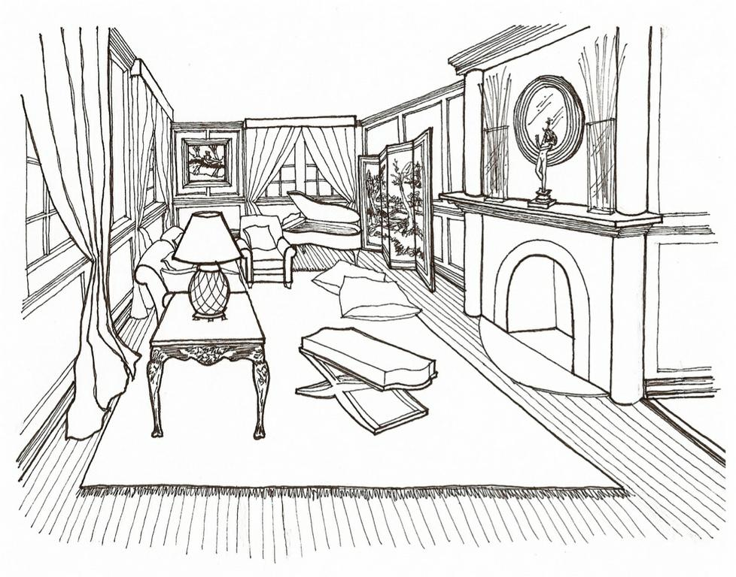
Line Drawing

Slide 5
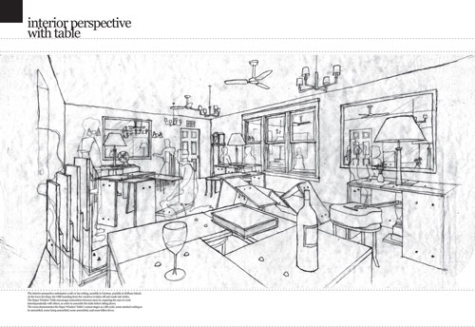

Slide 6
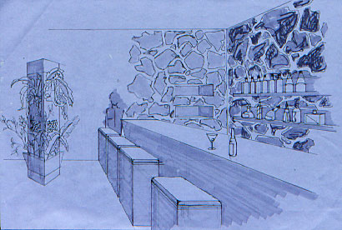

Slide 7
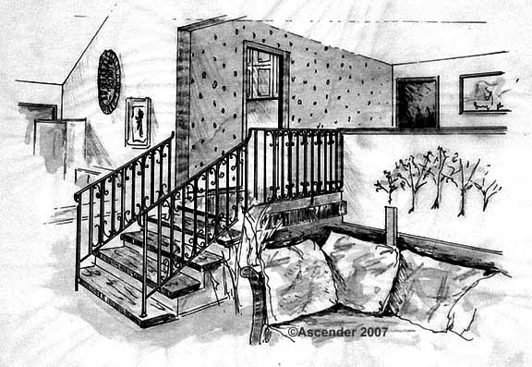

Slide 8
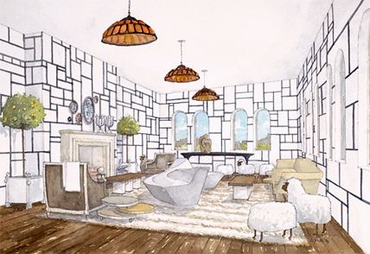
RENDERING
When color, shades, shadows, pattern, and texture is added to an interior perspective drawing.

Slide 9
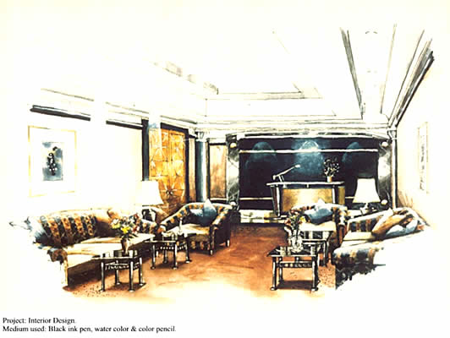

Slide 10
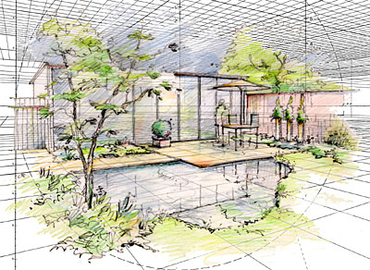

Slide 11
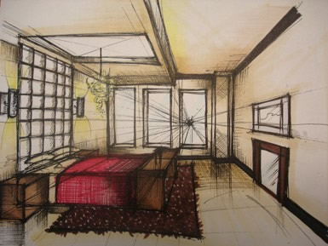

Slide 12
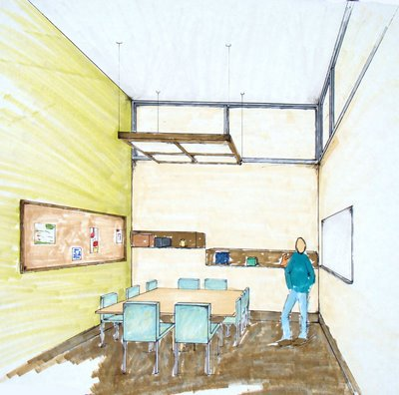

Slide 13
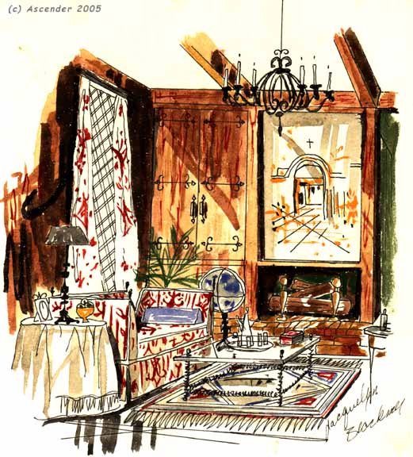

Slide 14
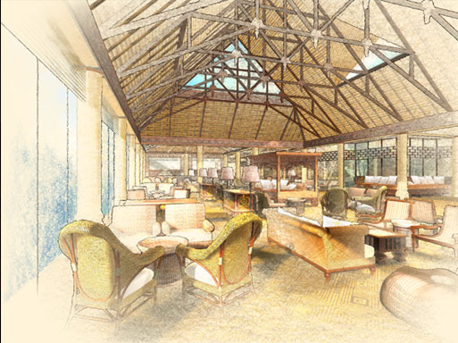

Slide 15
PRESENTATION FLOOR PLAN
Present not only the layout of rooms in a home, but may include traffic patterns, appliances, and furniture arrangement. Color may also be added to define areas.

Slide 16
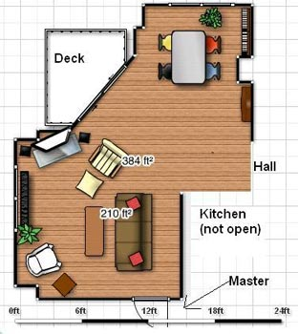
Floor plan & furniture arrangement

Slide 17
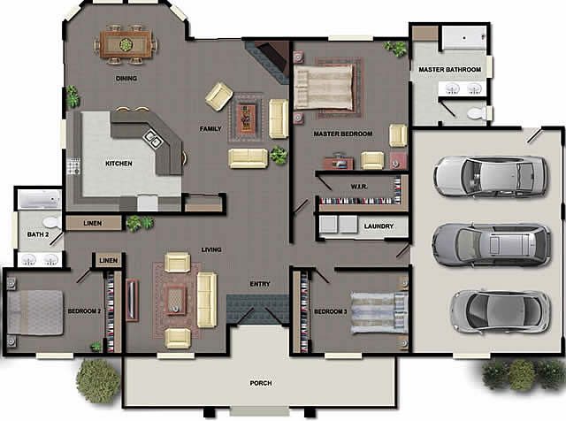

Slide 19
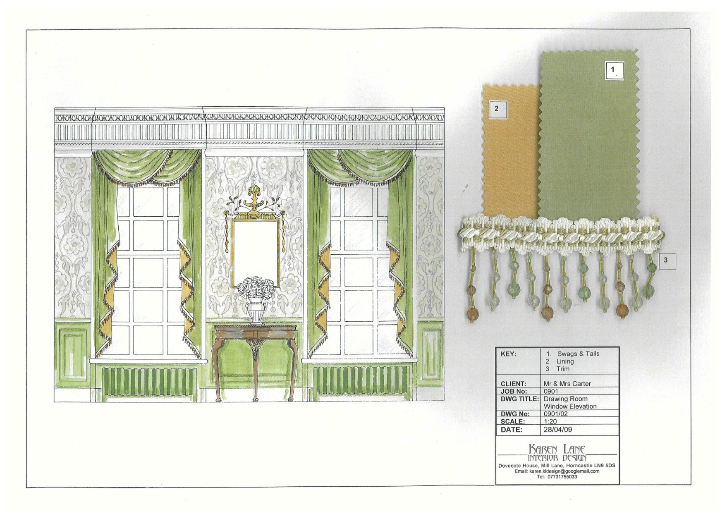
PRESENTATION ELEVATION
Represents sides of a room, but displays no depth

Slide 20
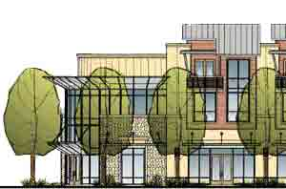

Slide 21
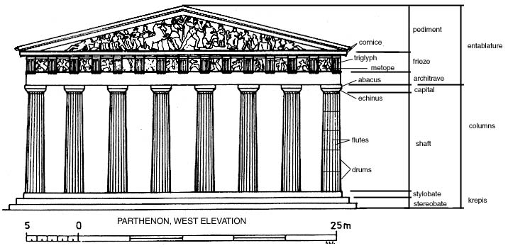

Slide 22
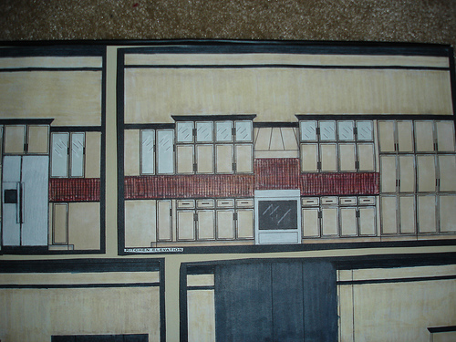

Slide 23
PRESENTATION BOARD
Enables a client to visualize the proposed finished product by displaying colors, designs, and textures that will be used in the completed room. Mat board or illustration board is used for mounting manufacturers samples, drawings, and photos
Some of the following boards are better than others… help me decide which ones

Slide 24
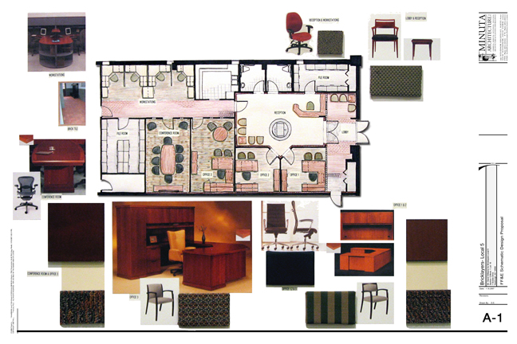

Slide 25
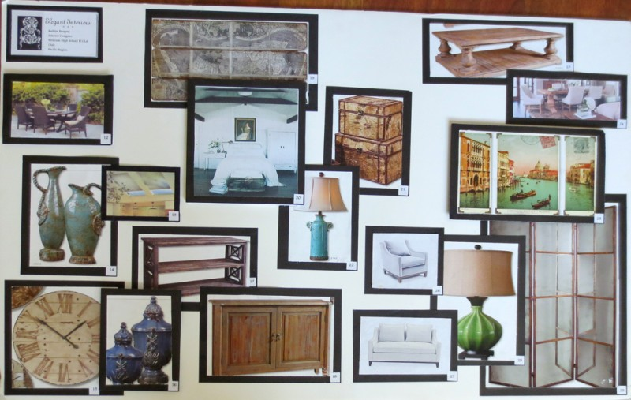
Sample Board

Slide 26
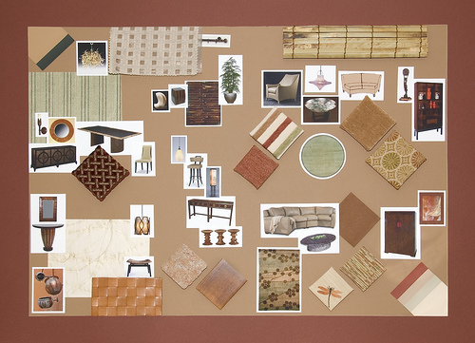

Slide 27
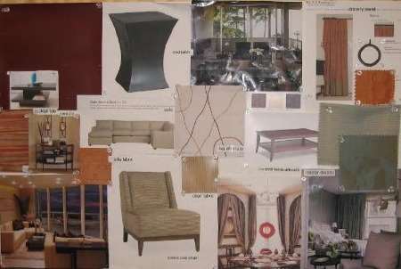

Slide 28
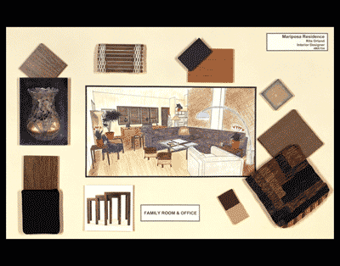

Slide 29
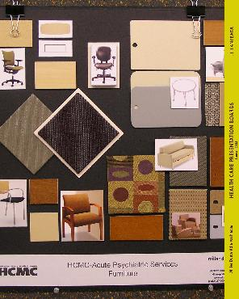

Slide 30
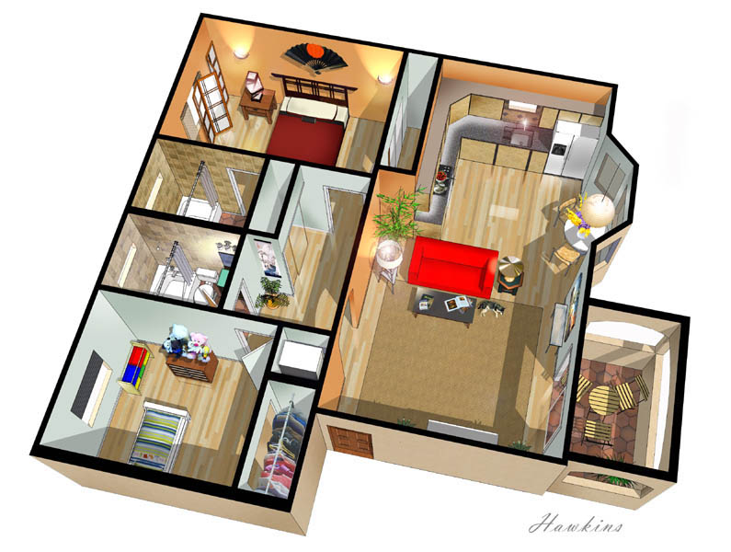
MODELS
May be used by the designer to allow the client to view all sides of a proposed project by showing a three-dimensional likeness

Slide 31
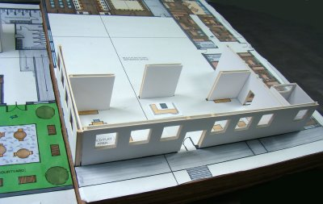

Slide 32
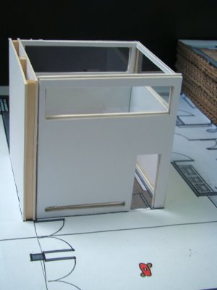

Slide 33
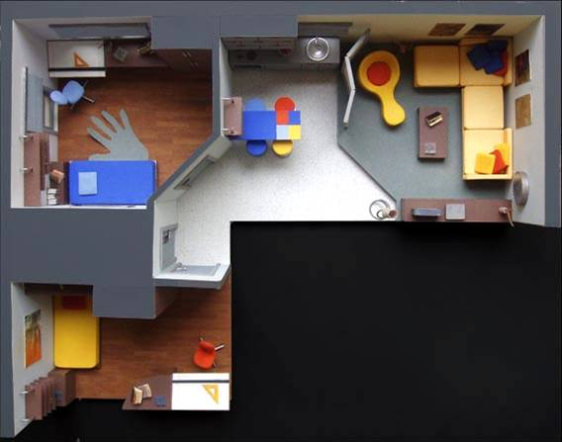

Slide 34
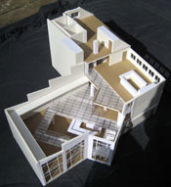

Slide 35
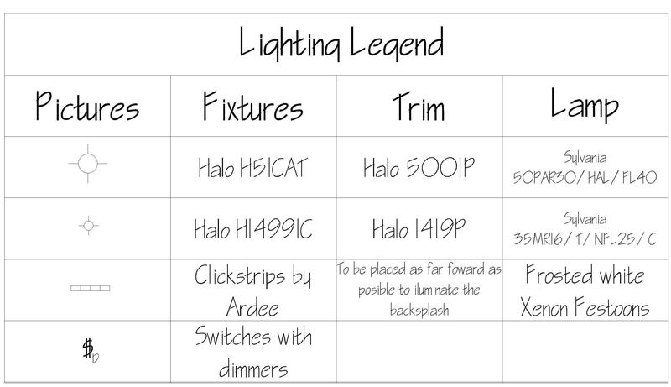
KEY/LEGEND
A rectangular space on a project used to reference symbols, materials, or placement of project parts.

Slide 36
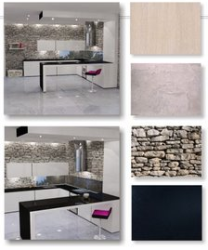
TEXT/LETTERING
A plan without text does not communicate a complete description of the various components. Appropriate text helps communicate information, but also makes the presentation look professional.

Slide 37
ARCHITECTURAL LETTERING

Slide 38
LETTERING RULES
All projects must have a title. Check the spelling of all words for accuracy
Always use guidelines when lettering
Block lettering is the basic lettering and is acceptable for project presentations
Letters should be bold and clear. Avoid making fancy, cute letters
*Use sans serif lettering

Slide 39
LETTERING RULES
Make each line quickly from the beginning to the end of the stroke. This makes the lines straighter and more accurate.
Begin the letter with a straight line, then add diagonal and curved lines.
Letters will be written in a variety of sizes. Generally, the smaller the letter, the easier it is to write. Practice lettering in a variety of sizes.

Slide 40
LETTERING RULES
Block letters are usually all CAPITALIZED
The size of lettering is usually related to the importance of the labeling. For example, titles are lettered larger than notes in small areas
Spacing between letters and words is critical. Think of all the letters as being the same size, approximately square (“M” and “W” are a little wider.)

Slide 41
LETTERING RULES
Labeling should be done from left to right
Keep borders simple--they unite the project and make it look professional
Rounded letters will slightly top the guidelines and can be slightly closer together than straight letters
Do NOT cross “J” and “I”

Slide 42
LETTERING RULES
Use a soft pencil, but be careful not to smudge your lettering
Keep the point on your pencil sharp at all times—a mechanical pencil is great!
Rest your hand on a separate piece of paper to avoid smudging your lettering

Slide 43
LETTERING RULES
After you have experimented with many styles and learned one that works for you, be consistent with that style
Be consistent in your spacing of letters and words.
Practice! Practice! Practice!

Slide 44
Architectural Lettering Video
www.youtube.com/watch?v=Kvyp-L m6BQ

Slide 45
MOUNTING

Slide 46
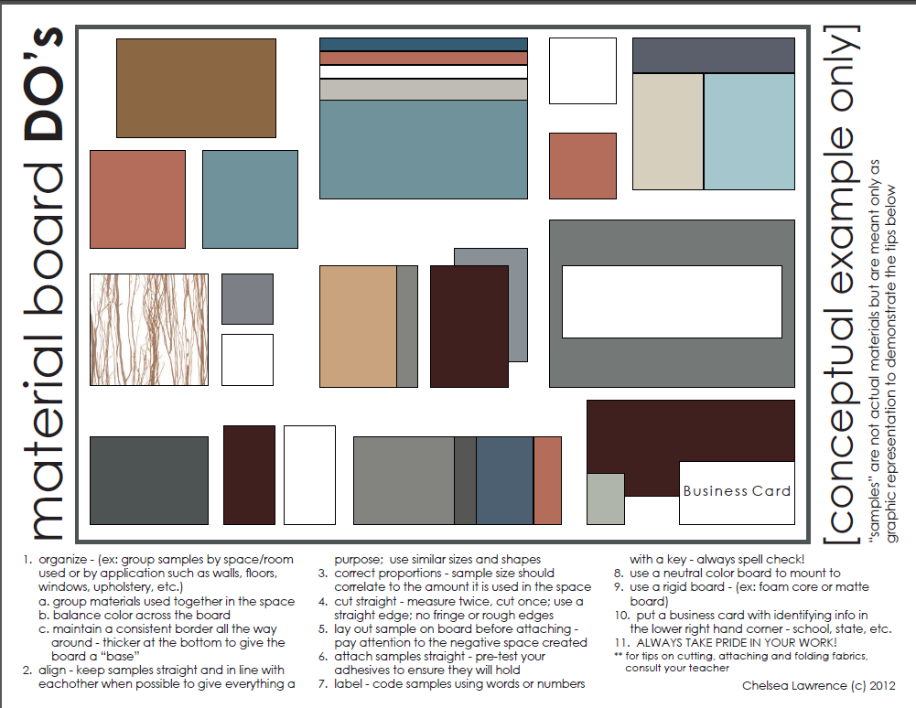

Slide 47
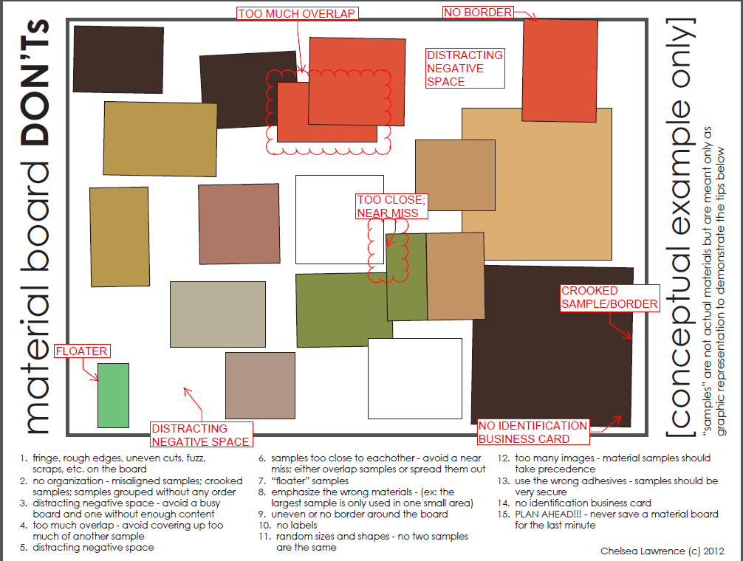

Slide 48
Sample Board Expectations
You must use the couch, chair, table and lamp
The rest are options for accessories
Decide on a color scheme:
2 paint samples
All samples need to be mounted with 1/4” borders
Come up with a title for your sample board!
Pay attention to placement of all samples

Slide 49
Board Examples. . . . . . .

Slide 50
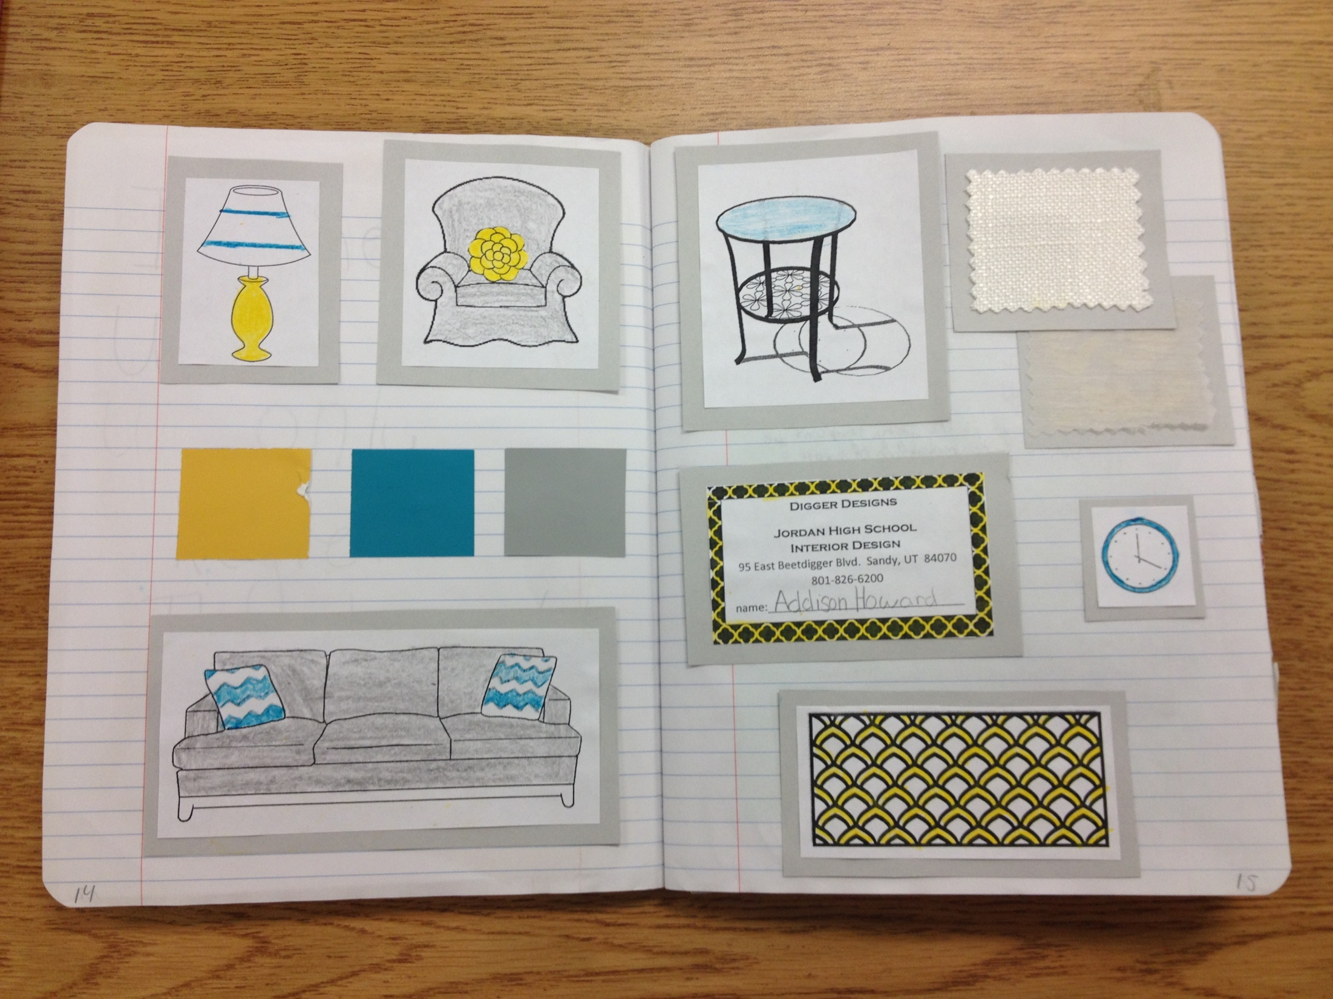

Slide 51
