Slide 1
CONVENIENCE FOODS

Slide 2
THREE LEVELS OF CONVENIENCE
BASIC
Canned, frozen, or dried foods with one or very few ingredients

Slide 3
THREE LEVELS OF CONVENIENCE
COMPLEX
Several ingredients with more time-saving processing
These often cost more than homemade

Slide 4
THREE LEVELS OF CONVENIENCE
MANUFACTURED
Cannot be made at home
Relatively expensive because of production technology

Slide 5
Let’s Practice...

Slide 6
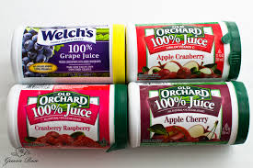

Slide 7
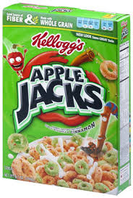

Slide 8
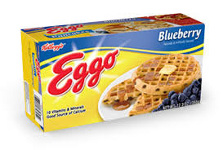

Slide 9
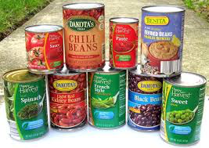

Slide 10
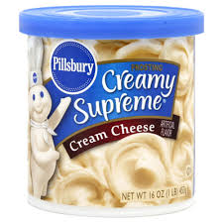

Slide 11
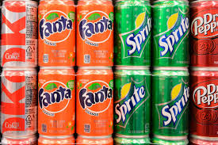

Slide 13
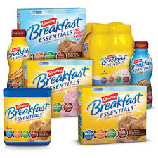

Slide 14
