Slide 1
Sports Nutrition

Slide 2
Exercise Myths: True or False?
The more you sweat, the more calories you burn.
Walking a mile burns the same amount of calories as running a mile.
The best time to exercise is in the evening.
Gatorade is the best fluid replacement to drink during and after exercise.
Regular activity does not have the health benefits that vigorous exercise offers.
FALSE
TRUE
FALSE
FALSE
FALSE

Slide 3
Who plays or has played a sport?

Slide 4
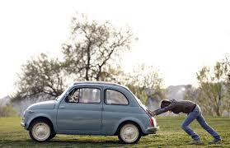
Why is nutrition an important aspect of sports?
Notes:
Nutrition is crucial for top performance. If you don’t fill your car up with gas (nutrients) then you can’t perform. Also if you fill up with crappy gas then you will ruin your vehicle (your body!)

Slide 5
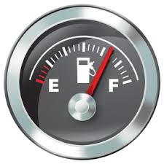
How much Fuel?
Most sedentary adults need 2,000-3,000 calories
Active teen girls need 2,200-3,500
Active teen boys need 3,000-5,000
They aren’t just being more active, they are also GROWING!

Slide 6
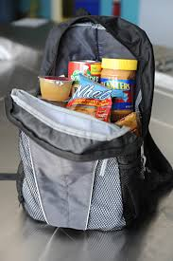
Fueling Up
Need snacks throughout the day to boost calories
Backpack friendly snacks:
Trail mix
PB & Crackers
Granola bars

Slide 7
Eat Like an Olympian Video

Slide 8
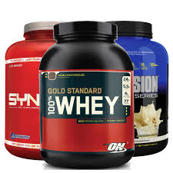
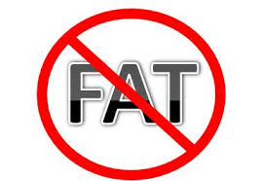
Ratio of calories
Carbs: 55-60%
Fat: 20-25%
Protein: 15-20%

Slide 9
Is Fat Bad?
Fat is an essential nutrient, especially for athletes!
Provides energy for endurance or low intensity exercise (>90 mins)
Omega 3 fatty acids reduce inflammation
Provides a role in cell signaling
Go for low fat and healthy fats, but don’t eliminate fat
Notes:
Neurons are sheathed with fat so it helps transport messages throughout the body

Slide 10
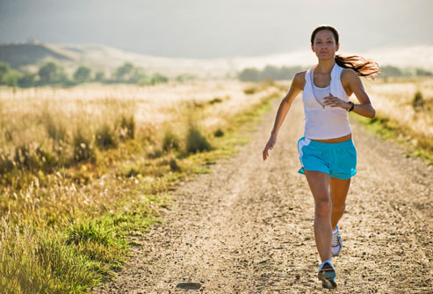
Pressure to be Skinny
Being skinnier does NOT mean you will perform better!
Notes:
USU girls XC team

Slide 11
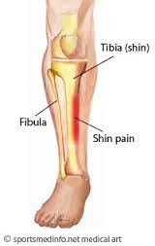
Symptoms of not enough Calories
Irregular period
Amenorrhea
Absence of menstrual cycle > 3 months
Abnormal—see a doctor!
Musculoskeletal injuries (i.e. shin splints)
Bone density loss → stress fractures
Notes:
Menstruation can return in as little as five days when intake is increased

Slide 12
Tips for Athletes!
http://www.skinnymom.com/2014/02/19/8-ways-to-eat-like-an-olympic-athlete/

Slide 13
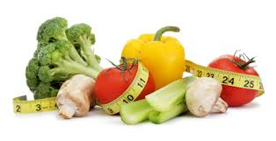
Highlights
Eat Breakfast
Natural foods (whole grains, produce, etc.)
Eat Frequently
Get enough Calories
Stay hydrated!
Avoid sugary drinks
and caffeine

Slide 15
Hydration
Start hydrating at least 4 hours before exercise
Drink a glass of water, milk, or 100% juice with every meal
Carry a water bottle around
Good indicator: urine should be pale yellow
Avoid Energy Drinks and Caffeine

Slide 16
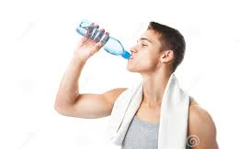
Why is hydration important?
Controls body temperature (sweating)
Affects blood pressure
Helps maintain electrolytes
Improve muscle recovery
Avoid muscle cramps
It is possible to drink too much water! (hyponatremia)
Notes:
Drinking too much water alters electrolytes and causes bodily harm

Slide 17
Hydration Video

Slide 18
During Exercise
Carbohydrates are the main source of energy during exercise
Consuming carbs during exercise….
Can reduce hypoglycemia (low blood sugar)
Prevent “hitting a wall”
Prevents breakdown of muscles for energy
Only necessary for prolonged exercise >60-90 mins

Slide 19
40-60 g of carbs/hour

Slide 20
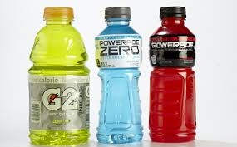
Hydration—during exercise
Water should be consumed in small amounts every 15-20 minutes
If exercise exceeds 45 mins or is in the heat, sports drink
Dilute with water 1:1 ratio

Slide 22
Recovery in 3 Stages
snack + fluid (w/in 15-60 mins) carbs & 10-15 g protein
meal + fluid (w/in 2 hours) mostly carbs, lean protein, and low fat
snack + fluid (w/in 4 hours) carbs & 10-15 g protein

Slide 23
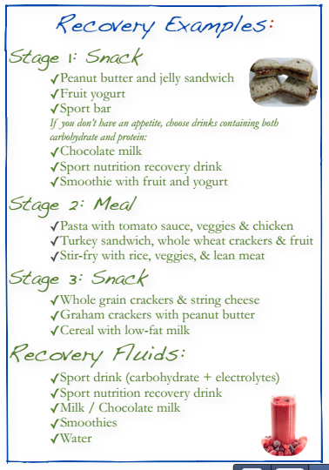

Slide 24
Replenish 150% of lost fluid after exercise

Slide 25
Pre & Post Workout
http://www.fitnessmagazine.com/recipes/healthy-eating/nutrition/best-workout-foods/?page=5

Slide 26
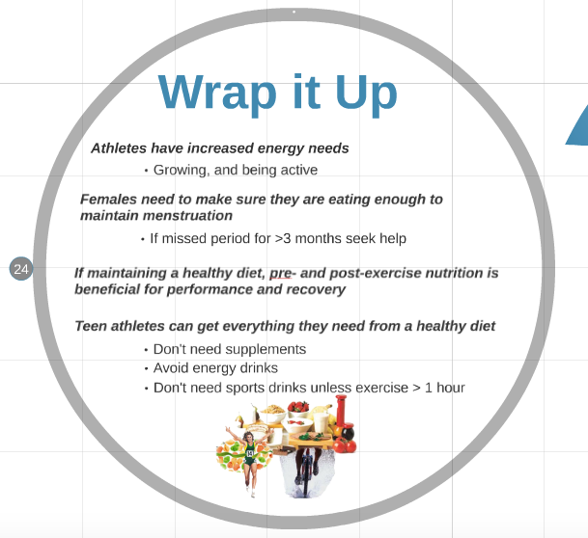

Slide 27
Amy Carston’s Slideshow:

Slide 28
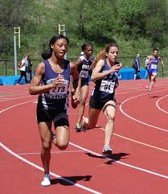
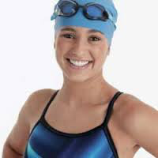
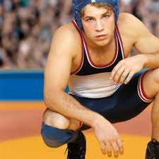
Calorie needs
Active teen girls need 2,200-3,500 calories per day
Active teen boys need 3,000-5,000 calories per day
Snacks eaten throughout the day can boost your calorie count

Slide 29
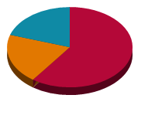
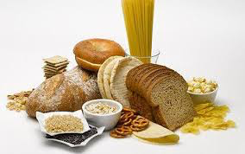
The goal
Athletes need to get about:
60% calories from carbohydrates
20% calories from protein
20% calories from fat
If you have a varied diet, you won’t need sports bars or dietary supplements

Slide 30
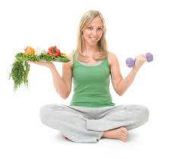
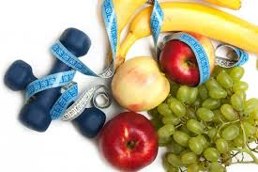
Pre-event/exercise
2-4 hours before competition or training, the athlete needs a complex, carb-rich meal (grains, fruit, starchy veggies, milk, yogurt) to top off muscle stores.
Consider a liquid meal if you’re nervous!
This meal should include a moderate amount of protein (reduces post-exercise soreness) and be low in fat and fiber-rich foods (take longer to leave your stomach, which can cause discomfort)

Slide 31
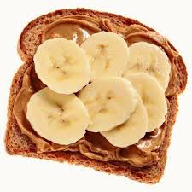
Pre-game meal ideas
3-4 Hours before:
Peanut butter and honey on toast + instant breakfast drink
Fruit and yogurt smoothie + low-fat granola
Oatmeal with brown sugar and almonds + skim milk + banana
30-60 minutes before:
Sports drink or water
Piece of fruit or jam sandwich

Slide 32
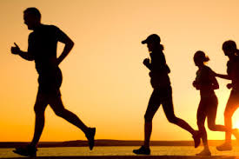
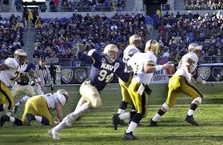
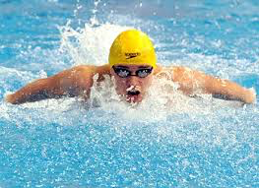
During event/exercise
During exercise, our bodies get energy from carbs
Stored in muscles as glycogen, used to fuel muscles as they work
Having enough glycogen can improve performance by preventing low blood sugar, and “hitting the wall”—being forced to slow down or stop
Not having enough carbs can cause the body to break down muscle for energy

Slide 33
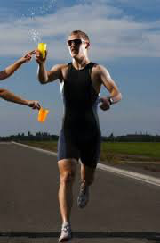
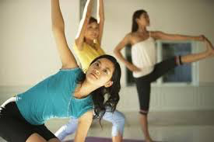
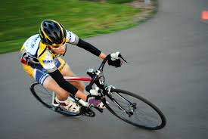
During exercise nutrition
Long exercise requires a blend of fluids, carbs, and electrolytes. Too little fluid or too many carbs can result in cramping and stomach problems
Prevent dehydration by hydrating enough to replace fluid lost from sweat

Slide 34
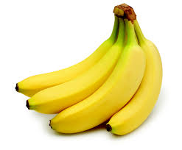
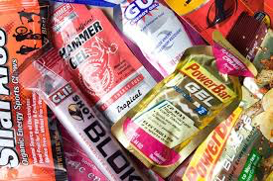
During exercise Ideas
Sports drinks with carbs and electrolytes (ONLY FOR PROLONGED EXERCISE!)
Easily digested carbs: banana, roll and honey, sports gels, granola bar
Consume fluids with carbs to speed fuel transport to muscles

Slide 35
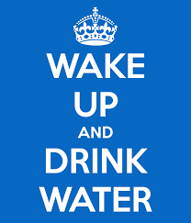
hydration
Water regulates temperature, blood pressure, nutrient concentration, and electrolyte levels, transports nutrients around the body, and helps with recovery
Dehydration leads to cramping, changes in blood pressure, and weight loss during exercise.
Dehydration can also delay recovery time and decrease performance

Slide 36
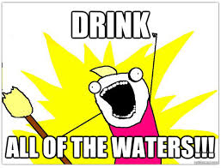
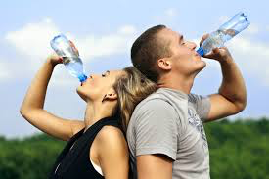
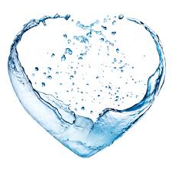
To prevent dehydration:
Drink water even if you aren’t thirsty!!
Drink 4-8 oz. of water every 15 minutes during an event
Sports drinks are okay for workouts over 45 minutes or when it’s hot
Monitor urine color (pale yellow is best) for optimal hydration

Slide 37
Hydration video

Slide 38
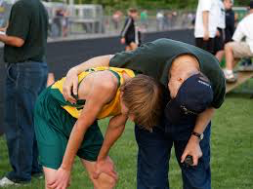
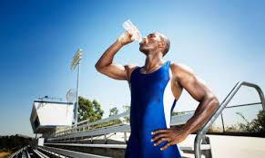
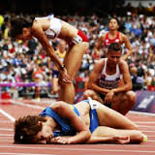
recovery
Body is primed to replenish lost nutrients soon after exercise
Start refueling within 15-60 minutes
Goal: Restore fluid and electrolytes lost in sweat, replace muscle fuel (carbs) lost in exercise, repair damaged muscle tissue with protein (especially if exercise was high intensity—resistance training, intervals)

Slide 39
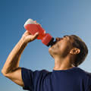
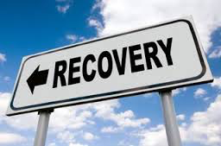
3 Stages of recovery
1. Snack and fluid: carb and 10-15g protein, within 15-60 minutes
Smoothie with yogurt and berries
Graham crackers with peanut butter + low-fat chocolate milk + banana
2. Meal and fluid: balance (mostly carbs, lean protein, low fat—remember 60-20-20), within 2 hours
Whole wheat pita + turkey and veggies + pretzels + low-fat milk
Rice bowl with beans, cheese, salsa, avocado + whole wheat tortilla
3. Snack and fluid: carb and 10-15g protein, within 4 hours

Slide 40
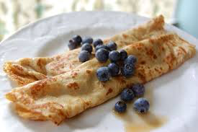
Recovery recipe
Crepes and Peanut Butter!

