Slide 1
Safety Guidelines, Work Habits & First Aid
Food and Nutrition Sciences 2

Slide 2
Scattergories – Kitchen Accidents

Slide 3
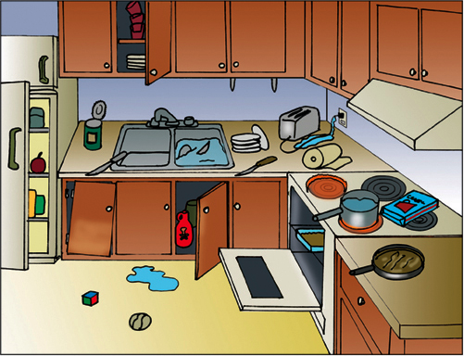

Slide 4
3 Major Lab Safety Issues

Slide 5
Prevention: Cuts
Wash knives separately
Put all broken glass in the SHARPS BIN
Remove can lids completely, place in the sharps bin
The best knives are SHARP knives, because they use LESS PRESSURE

Slide 6
First Aid: Cuts
If it’s spurting, we get emergency help (arterial cut)
If it’s oozing (as most cuts will), you need to do the following:
  Wash with soap and water
  Apply direct pressure
  Clean up and bandage
  Any more than that, we can get the nurse

Slide 7
Prevention: Spills
#1 Rule in this class: CLEAN IT UP…QUICK!
Spills lead to slips and falls.
Use a floor towel

Slide 8
First Aid: Spills
If the person fell because they slipped on a spill, we PICK THEM UP
  Unless… they hit their head. DO NOT move them and tell the teacher right away. Moving a person with a head injury could cause further damage or paralysis.

Slide 9
Did you know??
  When water reaches 156 degrees, it can cause a third degree burn in an adult in one second. (That’s still 40 degrees less than boiling water).

Slide 10
Prevention: Burns
Use oven mitts and hot pads
Open lids away from you (to avoid steam burn)
No hanging jewelry or loose clothing
Wear an apron
Avoid touching hot surfaces
Clean up spills immediately!

Slide 11
First Aid: Burns
Run cold water over the area or apply a wet, cold cloth. NOT ice. Ice can cause further tissue damage by freezing the skin
If you are on fire, stop drop and roll! (don’t run)
We will call 911 and/or get nurse
CHEMICAL BURNS: Flush with water

Slide 12
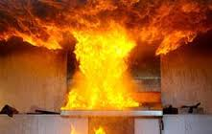
GREASE FIRES
CAUSE: Oil/fat left on heat too long, will spontaneously combust (light itself on fire)
PREVENTION:
use a thermometer
watch the oil (smoke
warning)
Lower or turn off the heat
REACTION:
Don’t panic
Baking soda or salt (lots)
Fire extinguisher
Lid (metal)
NEVER EVER EVER EVER EVER EVER put water on a grease fire. It will blow up!!!

Slide 13
Grease Fire Video
Grease Fire video

Slide 14
SUMMARY
What are the 3 main injuries that occur in the kitchen?
  How can we prevent them?
  How do we treat them?
Tell me about Grease fires? What do we NOT put on them?

Slide 15
Dishwashing
Scrape off any food into the garbage.
Rinse off the dishes.
Fill one sink with hot soapy water, fill the other with hot clean water.
Wash dishes in soapy water
Rinse dishes on other side of the sink
Dry promptly and put dishes away

Slide 16
Sanitize vs. Clean
Clean: to remove VISIBLE soil and food particles
Sanitize: use moist heat or chemical agents to reduce pathogens
  We need to SANITIZE, not just clean!

Slide 17
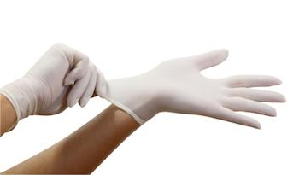
Glove Procedures
By law, gloves must be worn when handling ready-to-eat foods (think Subway)
Change gloves when
  1. They tear
  2. Before beginning a new task
  3. Every four hours when doing the same task
  4. After handling raw meat, fish, or poultry

Slide 18
How Clean Are You?
Video

Slide 19
Food Storage Quiz
Correct Answers:
#1 – B
#2 – A
#3 – B
#4 – C
#5 -- B

Slide 20
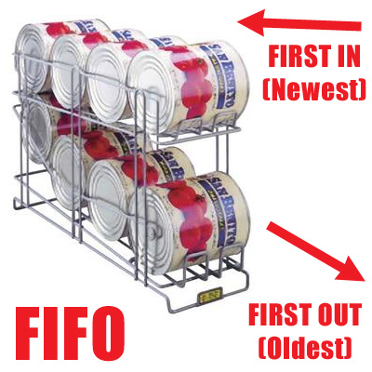
FIFO
First In, First Out
Leftovers should be consumed within two days, and should be reheated thoroughly

Slide 21
Food Borne Illnesses
Correct Answers:

Slide 22
Botulism: bottles & babies
Source
  Improperly canned foods
  Honey—never give honey to a baby under 1 years old
Symptoms
  Affects nervous system
  Double vision
  Not able to speak or swallow
  Babies: weak cry, floppy movements, constipation
Prevention:
  Don’t use bulging cans
  Don’t feed babies honey

Slide 23

E-Coli
Sources
  Undercooked ground beef
  Un-pasteurized milk & juice
  Fecal matter & infected soil
  Fruits & Vegetables
Symptoms
  Cramps
  Diarrhea
  Nausea
  Vomiting
  Fever
Prevention:
Make sure meat is properly cooked
Wash your hands!

Slide 24
Hepatitis A
Source
  Fecal matter
  Improper hand
  washing
Symptoms
  Fever
  Loss of appetite
  Nausea, Vomiting
  Jaundice
Prevention:
Wash your hands!

Slide 25
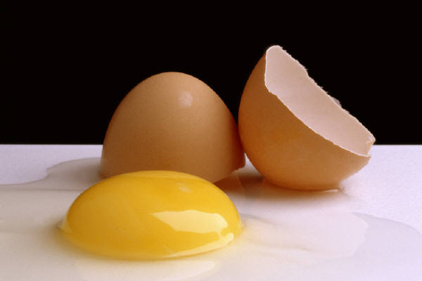
Salmonella
Source
  Fresh poultry
  Raw eggs
Symptoms
  Cramps
  Diarrhea
  Nausea
  Chills
  Fever
  Headache

Slide 26
Staphylococcus
Source
  Human skin, nose & throat; passed by not washing hands
Symptoms
  Nausea
  Vomiting
  Diarrhea
  **Similar to a nasty flu or cold

Slide 27
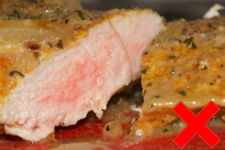
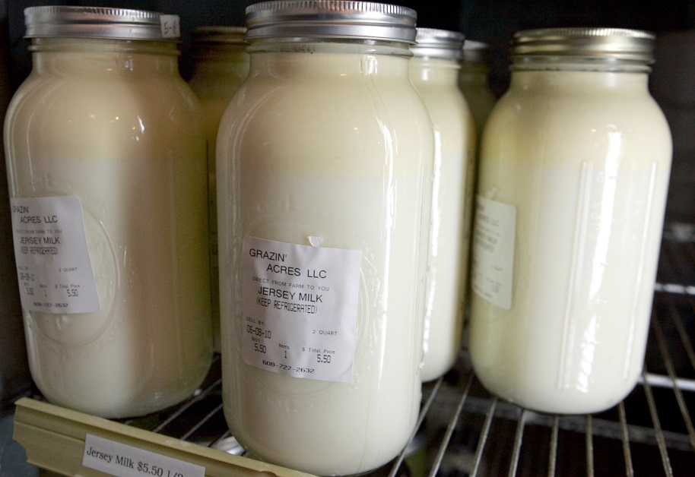
Campylobacter SSP
Source
  Raw and undercooked poultry
  Unpasteurized milk
  Contaminated water
Symptoms
  Upset stomach
Prevention
  Use a thermometer!
  Be careful of water sources

Slide 28
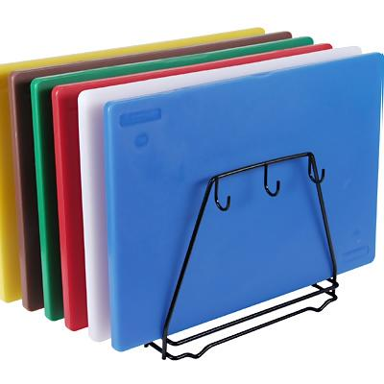
Cutting Boards
Nonporous, plastic
Anything that touches raw meat, poultry, or eggs must be sprayed with bleach, and washed with hot water and soap

Slide 29
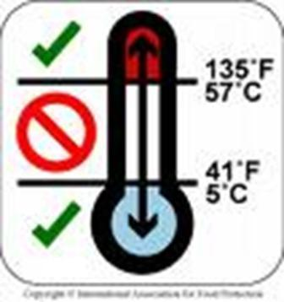
Danger Zone
41-135 degrees
  In between these temperatures, bacteria reproduce rapidly

Slide 30
Proper Thawing
In the fridge
In the microwave
NEVER on the counter, at room temperature

Slide 31
Proper Temperatures
When cooking, you must cook to a proper internal temperature to kill off harmful bacteria.
Seafood, beef, lamb, veal, pork (solid pieces): 145 °
Ground meats (beef, lamb, pork): 155 °
All poultry: 165 °
Reheat foods to 165 °
Freezer temperature:0 °
Cold storage of foods: 40 °or below

Slide 32
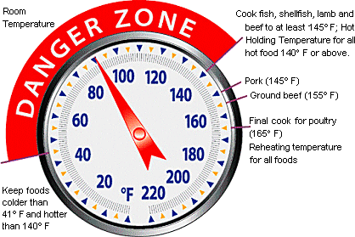
Prevention: Cooling & Reheating
Keep hot foods hot & cold foods cold!
Cooling - Hot foods should go from 135 to 70 degrees within two hours, and from 70-41 degrees within four hours

