Slide 1
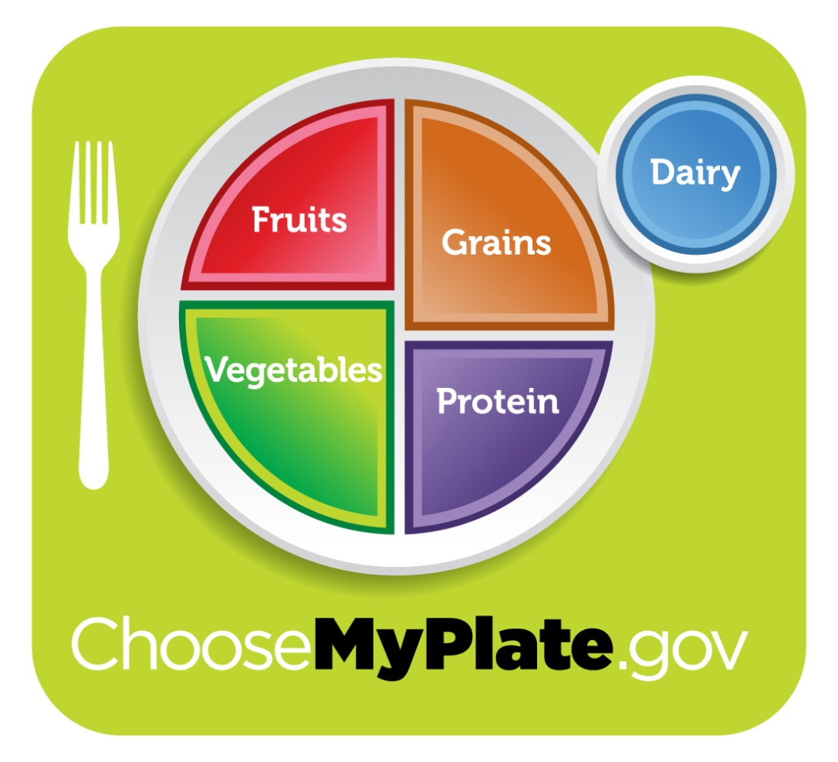
Choose My Plate and Dietary Guidelines

Slide 2
How are foods sorted into groups?
By Nutrient

Slide 3
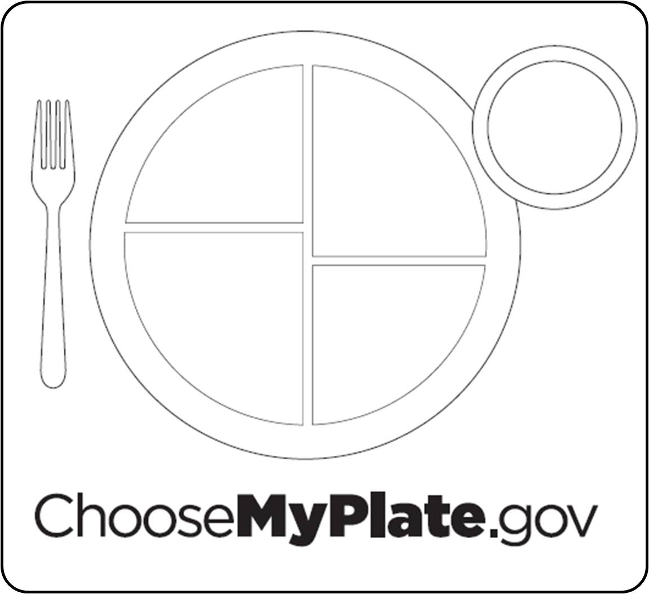
On Your Notes
For each section of MyPlate:
Write the FOOD GROUP
Write the COLOR
Write the TIP
Notes:
Any fruit or 100% fruit juice counts as part of the fruit group. Fruits may be fresh, canned, frozen or dried. They may be whole, cut up or pureed.
*The serving amounts indicated on the chart above are appropriate for individuals who get less than 30 minutes per day of moderate physical exercise beyond normal daily activities. Those who are more physically active may be able to consumer more while staying within calorie needs.

Slide 4
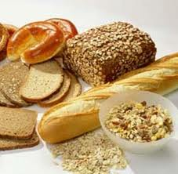
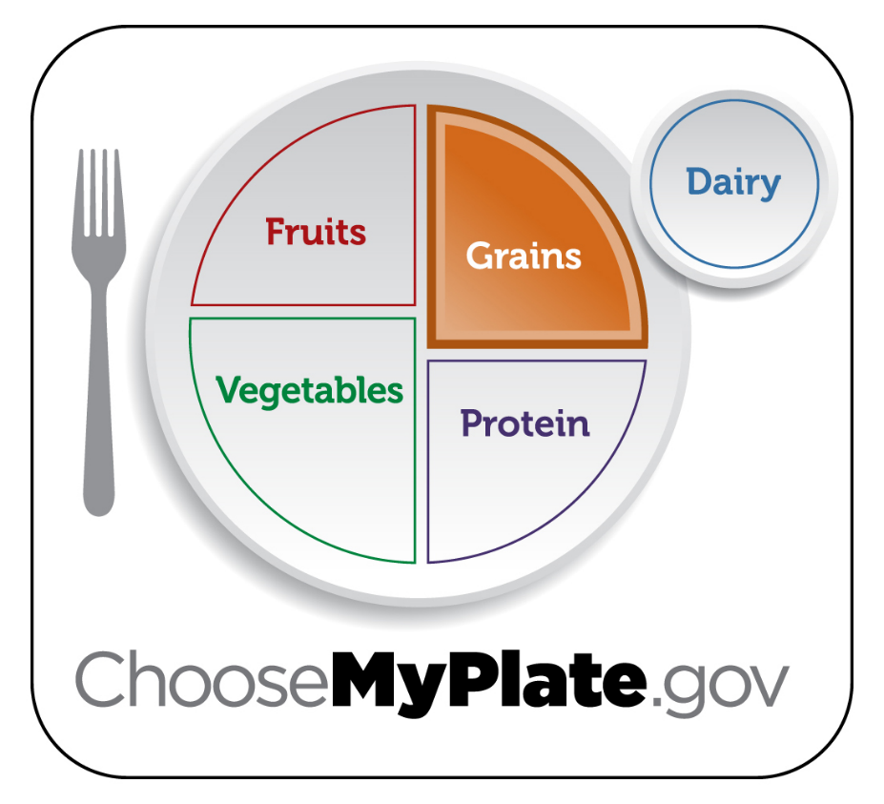
Grains 3-4 oz
Major Nutrient: Carbohydrates, Fiber
Serving: 1 oz = 1 slice bread – 1 cup dry cereal = ½ cup pasta
or rice
Tip: Make at least ½ your
grain whole grains

Slide 5
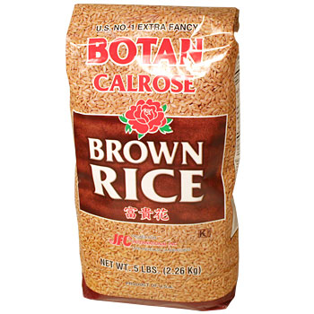
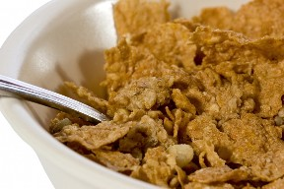
Make at least half your grain whole
Choose 100% whole-grain cereals, breads, crackers, rice and pasta.
Check the ingredients list on food packages to find whole-grain foods.

Slide 6
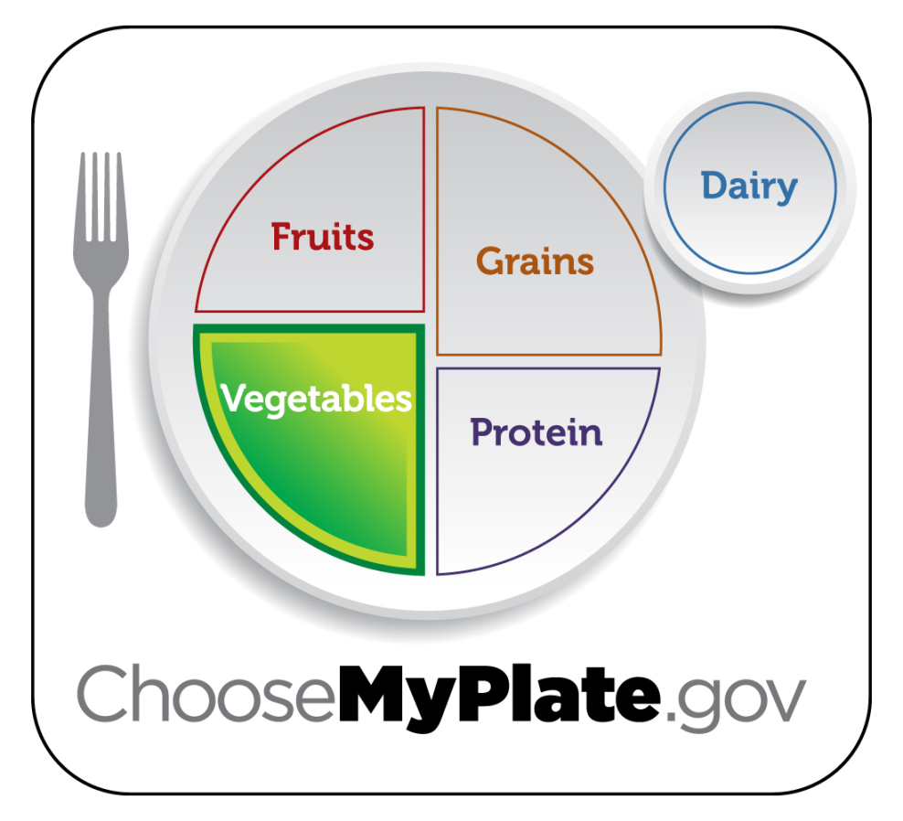
Vegetables 2 ½ - 3c
Major Nutrient: Vitamins, Fiber
Serving: ½ cup vegetables or 1 cup leafy vegetables
Tip: Make half your plate fruits
and vegetables

Slide 7
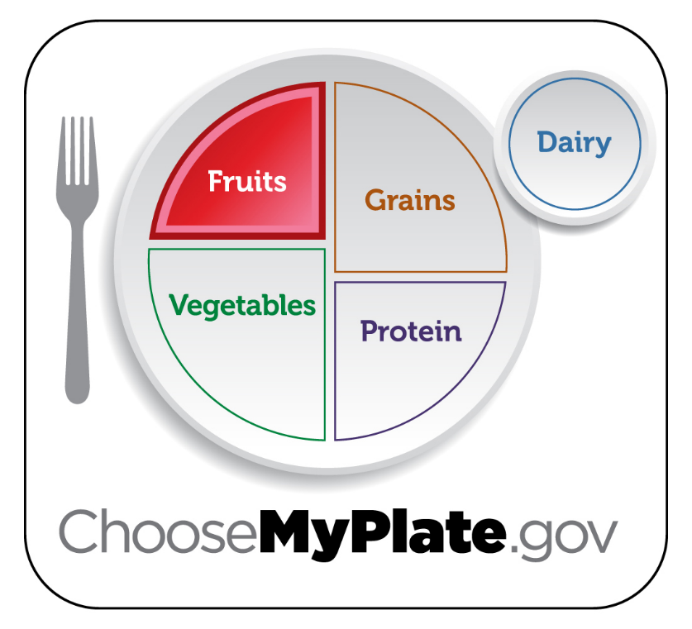
Fruits 1 ½ - 2 c
Major Nutrient: Vitamins, Fiber
Serving: 1 medium/small piece of fruit = 1 serving
Tip: Make half your plate
fruits and vegetables

Slide 8
Make half your plate fruits & vegetables
Choose fresh, frozen, canned or dried fruits and vegetables.
Eat red, orange, and dark green vegetables, such as tomatoes, sweet potatoes and broccoli in main and side dishes
Use fruit as snacks, salads or dessert
Choose whole or cut-up fruits more often than fruit juice.

Slide 9
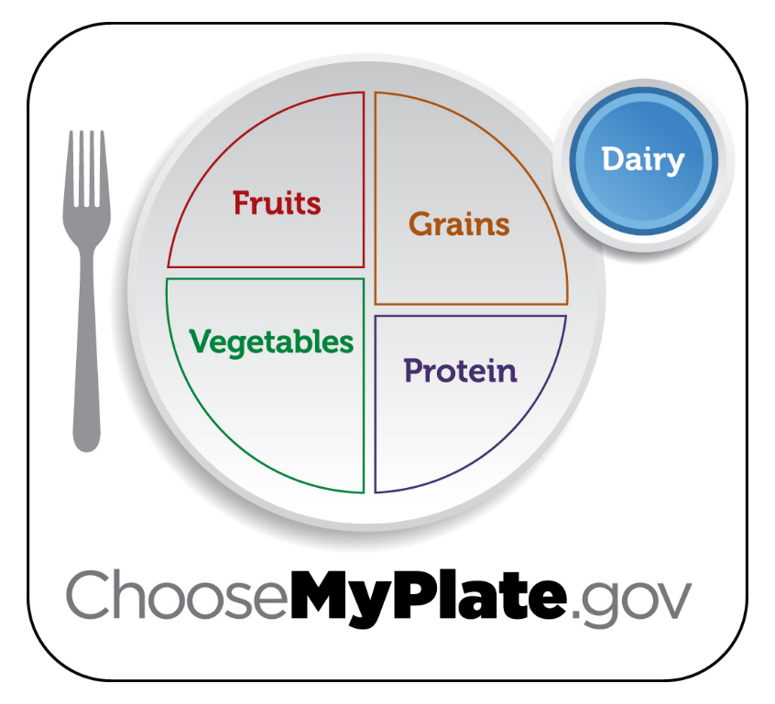
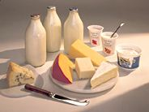
Dairy – 3 cups
Major Nutrient: Minerals, Protein
Serving: 1 ½ oz cheese or 1 cup milk/yogurt
Tip: Switch to fat free or
low-fat (1%) milk.

Slide 10
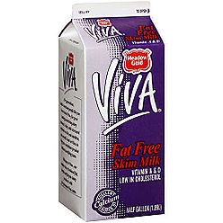
Switch to skim or 1% milk
About same amount of calcium and nutrients but less fat and calories!

Slide 11
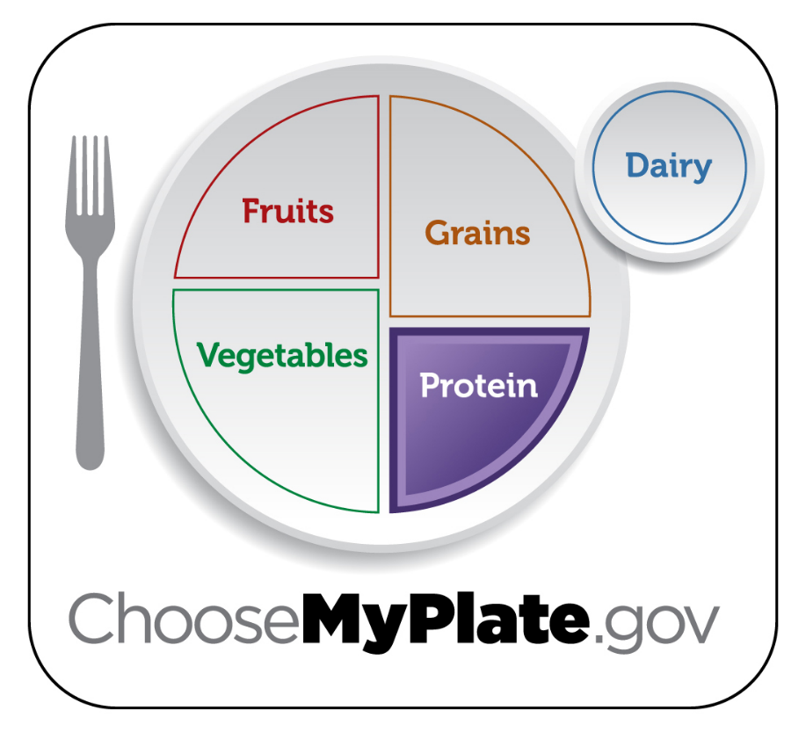
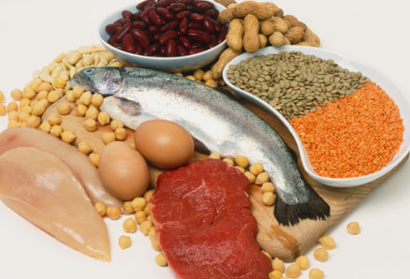
Proteins - 5-6 oz
Major Nutrient: Protein
Serving: 1 oz meat or 1 egg or 1 T peanut butter or ¼ cup cooked beans or ½ oz nuts or seeds
Tip: choose low fat or lean
meats, bake, broil or grill.
Vary protein.

Slide 12
Vary your protein food choices
Choose a variety of foods including seafood, beans and peas, nuts, lean meats, poultry and eggs.
Keep meat and poultry portions small and lean.
Try grilling, broiling, poaching or roasting. These methods do not add extra fat.

Slide 13
Cut back on foods high in solid fats, added sugars and salt
Choose foods and drinks with little or no added sugars.
Look out for salt (sodium) in foods that you buy.
Eat fewer foods that are high in solid fats.

Slide 14
The Dietary Guidelines

Slide 15
1. Eat Nutrient Dense Foods
Caloric Breakdown
Carbohydrates: 55-60%
Fat: No more than 30%
Protein: 10-15 %

Slide 16
1. Eat Nutrient Dense Foods
Average American eats too much fat, sugar, calories & sodium
Average American doesn’t eat enough fiber.
Nutrient Dense: Many nutrients, few calories

Slide 17
2. Balance calories to manage weight
A) Monitor food and beverage intake, physical activity and body weight.
B) Reduce portion sizes
C) When eating out, make better choices
D) Limit screen time (increase your activity)

Slide 18
Empty Calories
Many foods contain empty calories –- calories from solid fats and/or added sugars.
Solid fats and added sugars add MANY calories to the food but few or no nutrients. –
Solid Fats - solid at room temperature, like butter, beef fat, and shortening.
Added Sugars - sugars and syrups that are added when foods or beverages are processed or prepared
Notes:
http://www.choosemyplate.gov/what-are-empty-calories

Slide 19
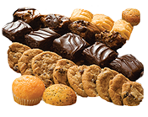
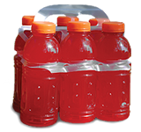
Cool. So what are some examples?
Cakes, cookies, pastries, and donuts (contain both solid fat and added sugars)
Sodas, energy drinks, sports drinks, and fruit drinks (contain added sugars)
Cheese (contains solid fat)
Pizza (contains solid fat)
Ice cream (contains both solid fat and added sugars)
Sausages, hot dogs, bacon, and ribs
(contain solid fat)

Slide 20
3. Reduce sodium, fats, added sugars, refined grains & alcohol
What can too much salt/sodium
do to your body?
Cause high blood pressure and heart disease.
Where does it hide?
In already prepared foods (frozen, canned, etc.)
Compare numbers in foods like soup, bread, and frozen meals and choose the foods with lower numbers.

Slide 21
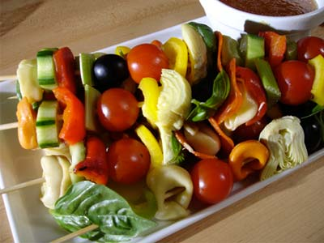
4. Increase vegetables, fruits, whole grains, milk, seafood and use oil instead of fat
It’s recommended that we eat 8 oz of seafood per week

Slide 22
5. Build healthy eating patterns that meet nutritional needs over time at an appropriate calorie level.

Slide 23
6. Include physical exercise as part of healthy eating patterns

Slide 24
Recommendations for Physical Activity
Kids 2-5 – Let them play!
Kids/
Teenagers 6-17 – 60 minutes a day
Adults – At least 2.5 hours a week moderate exercise

