Slide 1
Safety Rules & Guidelines
Food and Nutrition Sciences 1

Slide 2
Scavenger Hunt!
Please look at the following picture for 3 minutes and note all of the UNSAFE aspects of the picture.
You have THREE MINUTES.

Slide 3
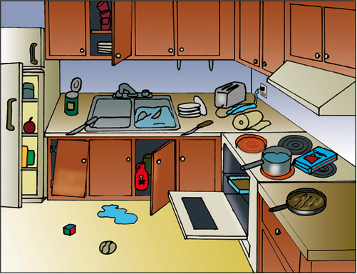

Slide 4
Scattergories – Kitchen Accidents
Guesses for top three?

Slide 5
3 Major Lab Safety Issues

Slide 6
How can we prevent these accidents?
Oven mitts
Immediate clean up
Prior knowledge of equipment
“Yellow” state--caution
Awareness/placement
Careful planning of lab assignments

Slide 7
Prevention: Cuts
Wash knives separately
Put all broken glass in the SHARPS BIN
Remove can lids completely, place in the sharps bin
The best knives are SHARP knives, because they use LESS PRESSURE
Dull knives are more dangerous and less efficient
If you break a dish, put it in the sharps bin

Slide 8
First Aid: Cuts
If it’s spurting, we get emergency help (arterial cut)
If it’s oozing (as most cuts will), you need to do the following:
Wash with soap and water
Apply direct pressure
Clean up and bandage
Any more than that, we can get the nurse

Slide 9
Prevention: Spills
#1 Rule in this class: CLEAN IT UP…QUICK!
Spills lead to slips and falls.
Use a floor towel
Stand on a stool to reach things too high for you!

Slide 10
First Aid: Spills
If the person fell because they slipped on a spill, we PICK THEM UP
Unless… they hit their head. DO NOT move them and tell the teacher right away. Moving a person with a head injury could cause further damage or paralysis.

Slide 11
Did you know??
When water reaches 156 degrees, it can cause a third degree burn in an adult in one second. (That’s still 40 degrees less than boiling water).

Slide 12
Prevention: Burns
Use oven mitts and hot pads
Open lids away from you (to avoid steam burn)
No hanging jewelry or loose clothing
Wear an apron
Avoid touching hot surfaces
Clean up spills immediately!

Slide 13
First Aid: Burns
Run cold water over the area or apply a wet, cold cloth. NOT ice. Ice can cause further tissue damage by freezing the skin
If you are on fire, stop drop and roll! (don’t run)
We will call 911 and/or get nurse
CHEMICAL BURNS: Flush with water

Slide 14
General Safety Knowledge
Know first aid for cuts, spills, burns
Knife safety
Safety includes sanitation
Hair, jewelry, clothing, aprons, etc…is it in the way? Will it catch fire? Is it touching food?
Quick response clean-up is essential
Read appliance manuals first
NO horseplay, rough-housing
Avoid plastic on or near the range
Store heavy items on lower shelves
FIRE EXTINGUISHER

Slide 15
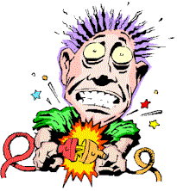
Prevention: ELECTRIC SHOCK!
Know how the equipment works!
Attach extra parts before plugging it in
Use dry hands, stand on dry floor
Make sure the cord is not near any water
Do not put near hot objects
Avoid “octopus outlets” (one outlet with many cords)
Disconnect appliances before cleaning them
Don’t use damaged appliances
Keep metal away (i.e. don’t use fork in a toaster)

Slide 16
Electric Shock: What to Do if It happens
Turn off the power source (do NOT touch the person!)
Remove the person from the object (towel)
Begin compressions if necessary, call 911

Slide 17
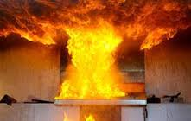
GREASE FIRES
CAUSE: Oil/fat left on heat too long, will spontaneously combust (light itself on fire)
PREVENTION:
use a thermometer
watch the oil (smoke
warning)
Lower or turn off the heat
REACTION:
Don’t panic
Baking soda or salt (lots)
Fire extinguisher
Lid (metal)
NEVER EVER EVER EVER EVER EVER put water on a grease fire. It will blow up!!!

Slide 18
Grease Fire Video
Grease Fire video

Slide 19
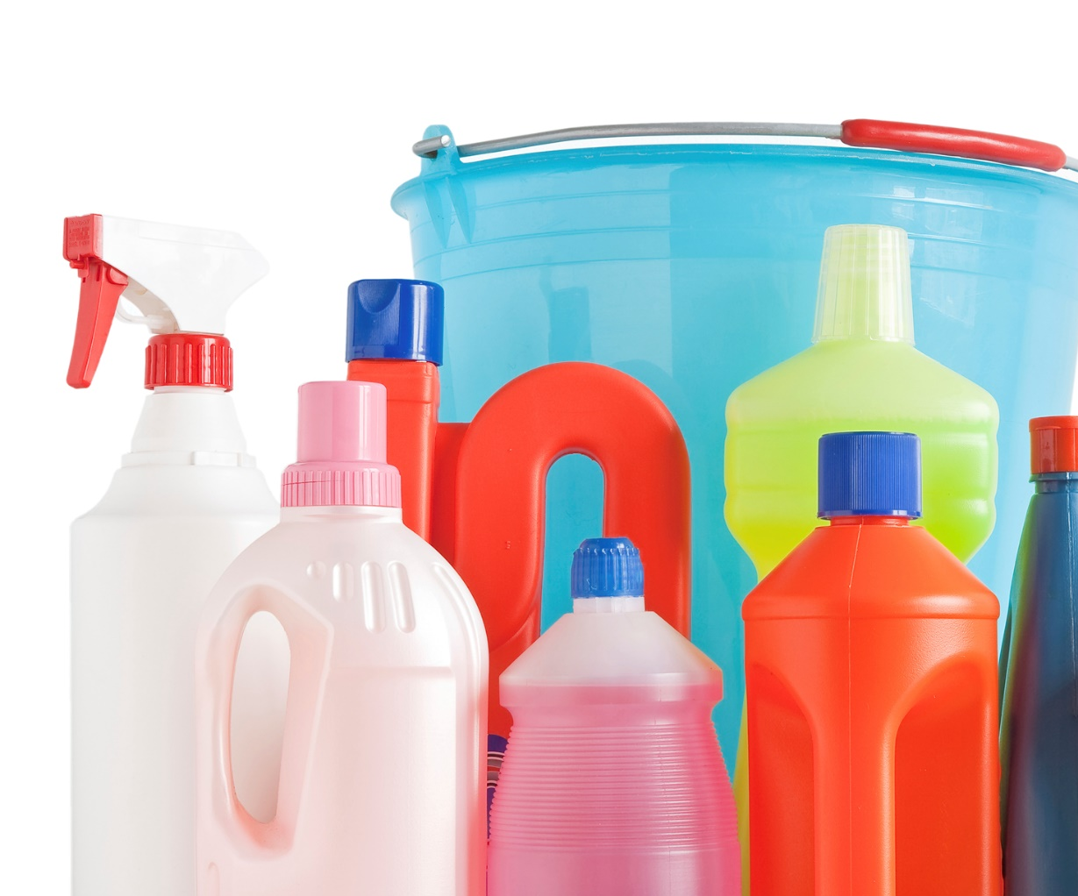
Cleaning Chemicals
Cleaning supplies should be stored away from foods
Keep cleaning supplies in original containers

Slide 20
A Special Note…
Know this for
the STATE TEST!!
When you combine CHLORINE (bleach) with AMMONIA it creates a
DEADLY GAS!!!!

Slide 21
SUMMARY
What are the 3 main injuries that occur in the kitchen?
How can we prevent them?
How do we treat them?
Tell me about Grease fires? What do we NOT put on them?

Slide 22
Hand Washing
Before and after handling raw meat, poultry
or eggs
1) Tip: Wash before, during and after cooking
2) Rinse in warm-hot water
3) Get soap, dime size
4) Scrub for 20 seconds (under nails, between fingers, up to the wrist)
5) Rinse in warm-hot water
6) Dry with clean towels

Slide 23
Hygiene Requirements for Food Handling
DOUBLE HAND WASH: when you wash your hands TWICE with soap and warm water, for 20 second each.
When do I need to do this?
After using restroom
After sneezing
After coughing
After blowing nose
Toughing eyes/mouth
After changing a diaper, etc.

Slide 24
Hand Washing Activity
Person #1 - 10 seconds cold water
Person #2 - 20 seconds cold water
Person #3 - 10 seconds with soap and warm water
Person #4 - 20 seconds with soap and warm water

Slide 25
Dishwashing
1) Throw away excess food
2) Fill one sink with hot soapy water, fill the other with hot clean water.
3) Wash dishes in soapy water
4) Rinse in clean hot water
5) Place dishes in drying rack
6) Dry with clean towel and put away

Slide 27
The food handler will know that food service gloves are capable of spreading germs and are not a substitute for proper handwashing.

