Slide 1
Microwave Cooking
Notes:
https://www.youtube.com/watch?v=xBaXpSUiry4

Slide 2
Microwaves
How Does It Work?

Slide 3
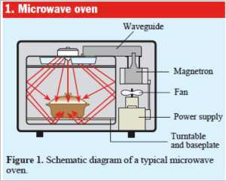
How Does It Work?
A magnetron tube is set in motion by a fan or a turn table, which emits electromagnetic waves.
Some areas get more microwaves, resulting in uneven cooking—rotating helps cook evenly

Slide 4
Microwave Emission
Waves are emitted from an opening in the metal case.
Waves are then reflected off the sides and penetrate food in the process.

Slide 5
How Does It Work?
Microwaves are attracted to water, fat, and sugar molecules causing them to vibrate and heat

Slide 6
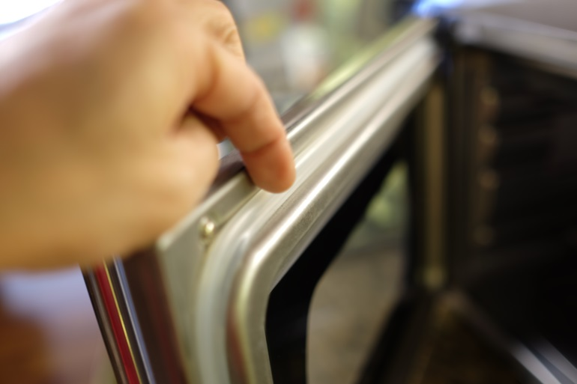
Safety Features
Door Safety Switch/Short Circuit Safety Switch (turns off when you open the door)
Seal around door
*Do not attempt to use if the door does not seal properly, is bent, or hinges or latches are broken!

Slide 7
Materials/Dishes
Best to use glassware, paper, or plastic dishes
Plastic and paper are good for reheating, but not for prolonged cooking. They cannot withstand high temperatures.
*Avoid wax coated materials, delicate glass and anything containing metal

Slide 8
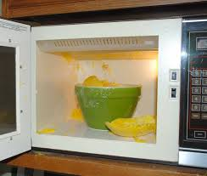
Be Careful!
Make sure steam can escape or have room to build up
Otherwise you could get burned , the food could splatter every where, or it won’t cook the food very evenly

Slide 9
What Not To Microwave
https://www.youtube.com/watch?v=xBaXpSUiry4

Slide 10
Shapes and Places
Foods cook around the perimeter edges first.
Position heavier/denser portions on the outside.
(Cooks only the outside 1-1 ½ inches)
Centers should be left empty, except when cooking one item.
Use a glass or bowl to keep the center open

Slide 11
Positions
At least 1” apart
2 items
3 items
4 items
5 or more items

Slide 12
Shapes and Places
Rotate dish(es) ¼- ½” once or twice during cooking
Round shapes cook more evenly
Corners have more energy passed through them and may overcook
High/tall foods close to the top also receive more energy

Slide 13
Cooking/Reheating
Stirring while cooking prevents uneven cooking
Cooking times will differ for every appliance as well as volume of food, size, and cooking utensil

Slide 14
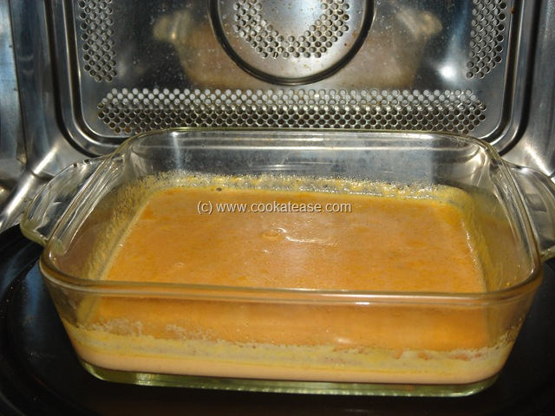
Standing Time
When food continues to cook after removed.

Slide 15
Benefits
Time Savings-cook 3-4 times faster than ovens
Energy Savings—Used up to 14% electricity of conventional oven and less power for a shorter period of time
No preheating
Auto-turn off
Quick and easy cleanup

Slide 16
Cons to using a microwave?
Don’t cook evenly
May cause weird texture
Cannot brown or crisp
“warming over flavor”

Slide 17
Browning
Additional ingredients can be used to create a browning effect:
Teriyaki/soy sauce
BBQ Sauce
Melted Butter
Bread crumbs
Shredded Cheese
Brown Sugar
Nuts
Jellies, Preserves, and Glazes

Slide 18
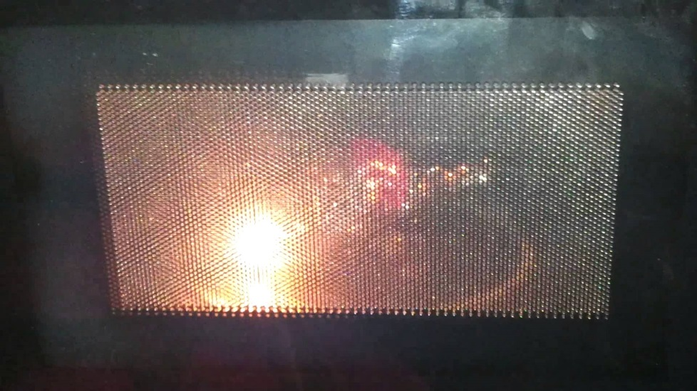
Arcing
Definition: electric sparks are produced when metal is used in a microwave, often times resulting in oven damage or fire.

Slide 19
10 things you didn’t know your microwave could do!
https://www.youtube.com/watch?v=SWdVeP-2-wk

Slide 20
Microwave Experiment!

Slide 21
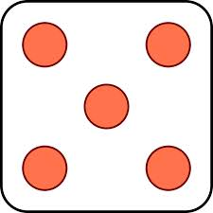
Why do we rotate food in the microwave?
Marshmallow activity
Get into your lab groups
Grab 5 marshmallows and place them on paper towels in an even arrangement:
Cook 25-30 seconds (REMOVE TURNTABLE)
Carefully remove from microwave and cool
Observe: size, color, texture

Slide 22
Standing Time
When food continues to cook after removed.
Cover while microwaving is similar to steaming- tenderize food and shorten cooking time
Shield some portions that are particularly sensitive to overcooking. Small amounts of foil can be used.

Slide 23
Microwave ideas
Notes:
http://extension.usu.edu/fscreate/files/uploads/Food_ense_Basics/Cooks/FCooksMicrowaveHandout.pdf

