Slide 1
KITCHEN EQUIPMENT
Food & Nutrition 1

Slide 2
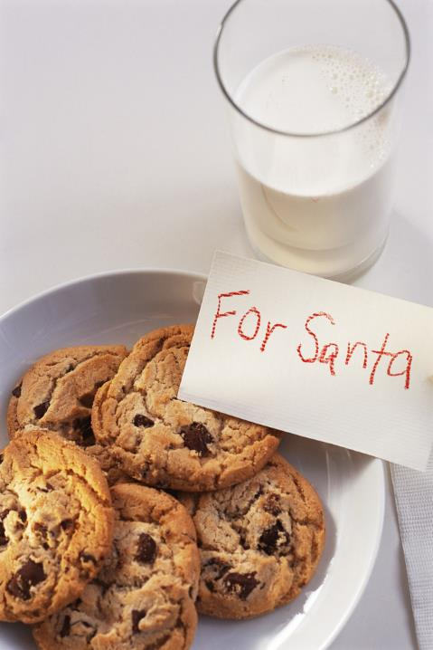
Stand up mixer …
what else?
Notes:
mixing spoon, rubber spatula, backing sheet, convection oven, conventional oven, hand mixer, cookie dough scoop, spoon, cooling rack, hot pads

Slide 3
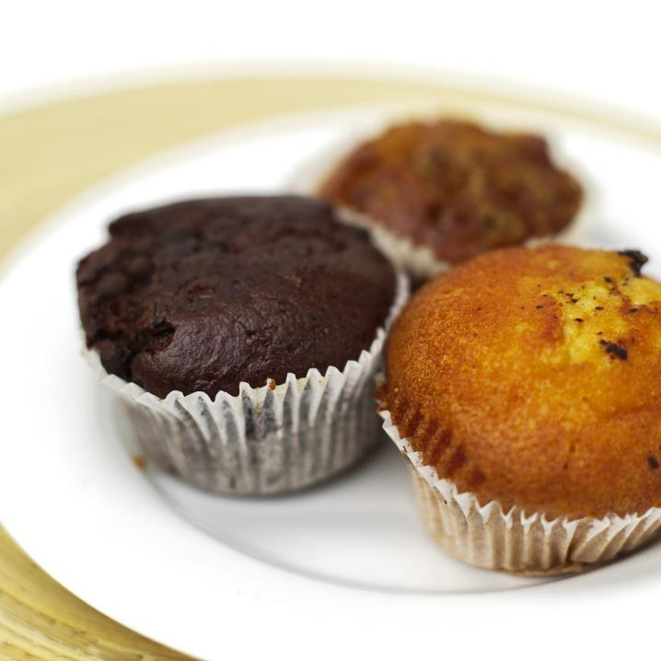
muffin tin ….
what else?

Slide 4
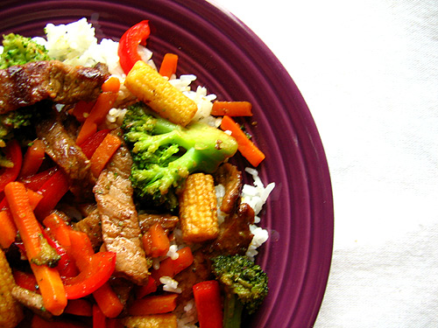
Electric skillet…
what else?

Slide 5
KITCHEN EQUIPMENT
Food & Nutrition 1

Slide 6
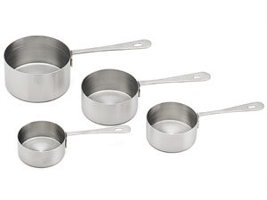
#1 Dry Measuring Cups
Use: measuring dry ingredients

Slide 7
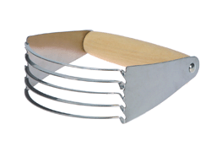
#2 Pastry Blender
Use: cutting fat into flour

Slide 8
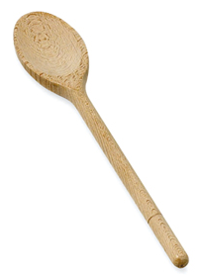
#3 Wooden Mixing Spoon
Use: stirring foods

Slide 9
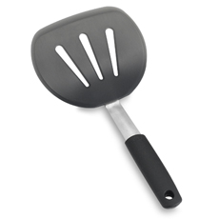
#4 Turner
Use: turning food
such as pancakes

Slide 10
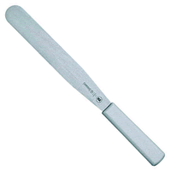
#5 Metal/ Flat Edge Spatula
Use: frosting cakes and
leveling ingredients

Slide 11
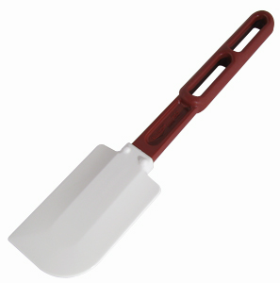
#6 Rubber Scraper/Spatula
Use: removing food
from pans or bowls

Slide 12
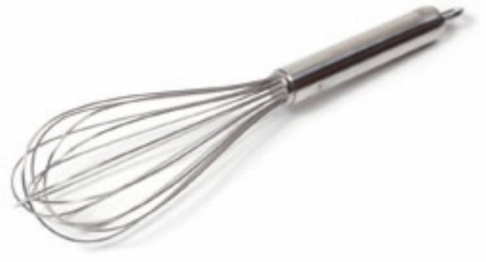
#7 Whisk
Use: stirring, beating, whipping

Slide 13
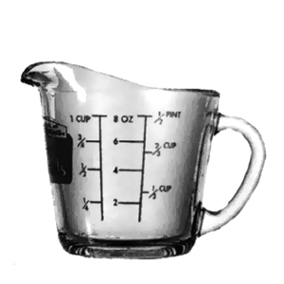
#8 Liquid Measuring Cup
Use: measuring liquid ingredients

Slide 14
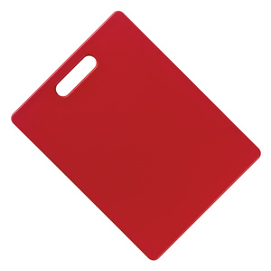
#9 Cutting Board
Use: protects the countertop and the knife

Slide 15
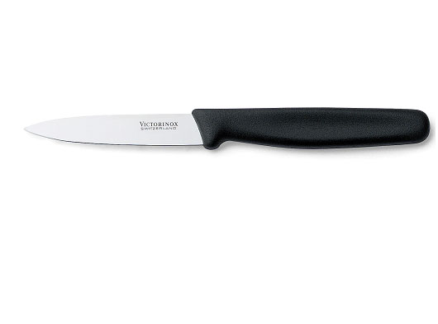
#10 Paring Knife
Use: removing the peel from fruits and vegetables

Slide 16
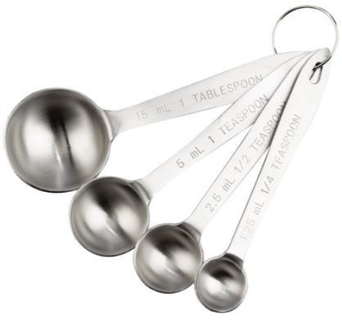
#12 Measuring Spoons
Use: measuring
ingredients less than ¼ cup

Slide 17
#14 Saucepan
Use: boiling and simmering

Slide 18
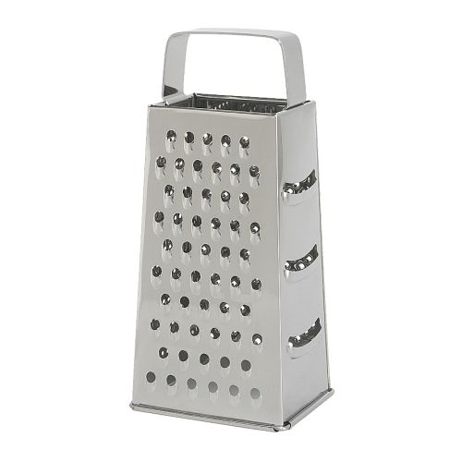
#15 Grater
Use: to grate/shred food into small pieces

Slide 19
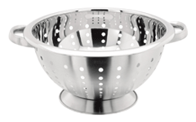
#17 Colander
Use: draining noodles or other large amounts of food

Slide 20
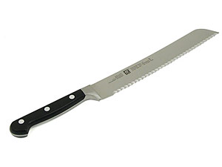
#18 Bread/Serrated Knife
Use: cutting bread

Slide 21
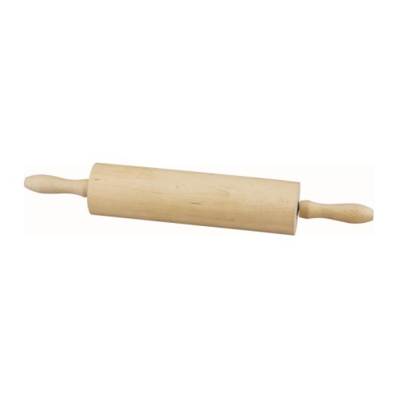
#19 Rolling Pin
Use: shaping and flattening dough

Slide 22
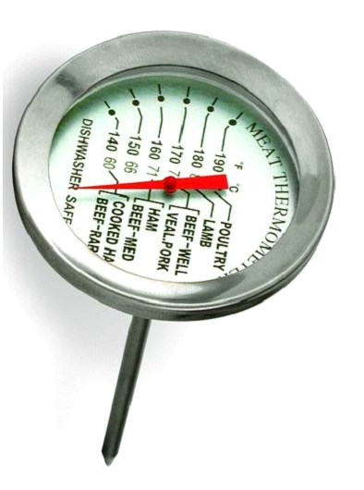
#20 Meat Thermometer
Use: measures the inside temperature of meats, poultry, etc.

Slide 23
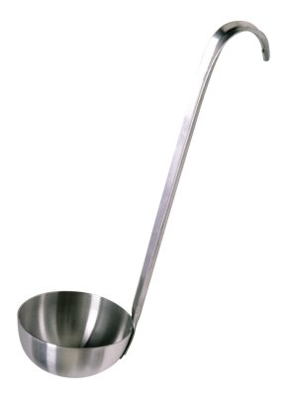
#22 Ladle
Use: removing liquids from pan

Slide 24
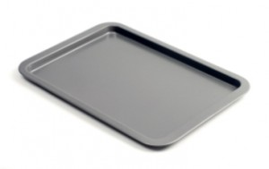
#23 Baking Sheet
Use: baking cakes, pizza, chicken pieces, fish, cookies, etc.

Slide 25
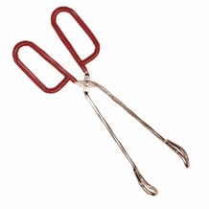
#24 Tongs
Use: gripping and lifting foods

Slide 26
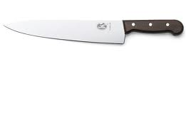
#25 Chef’s Knife
Use: slicing, chopping, dicing

Slide 27
Other Kitchen Equipment Items…

Slide 28
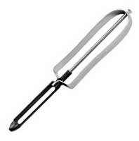
Vegetable Peeler
Use: removing the skin of
fruits and vegetables

Slide 29
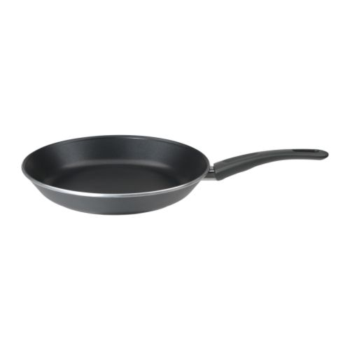
Skillet (Frying Pan)
Use: sautéing, stir frying, browning

Slide 30
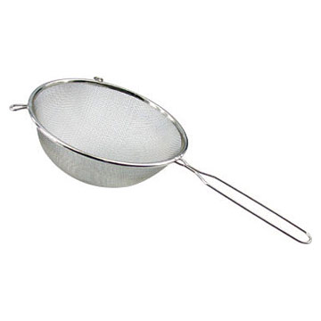
Strainer
Use: draining liquids from
small amounts of food

Slide 31
Equipment Makes the Food

Slide 32
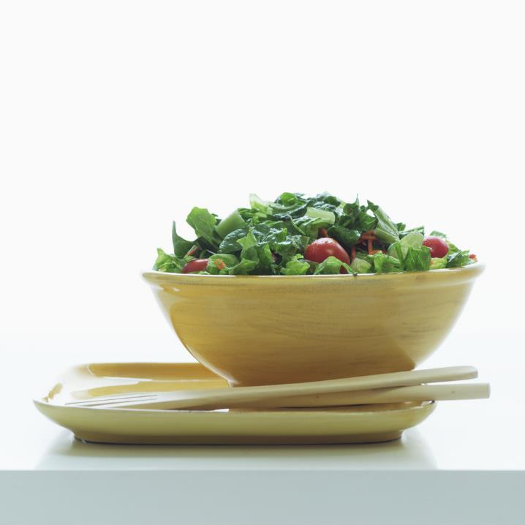
Chef’s knife…
what else?

Slide 33
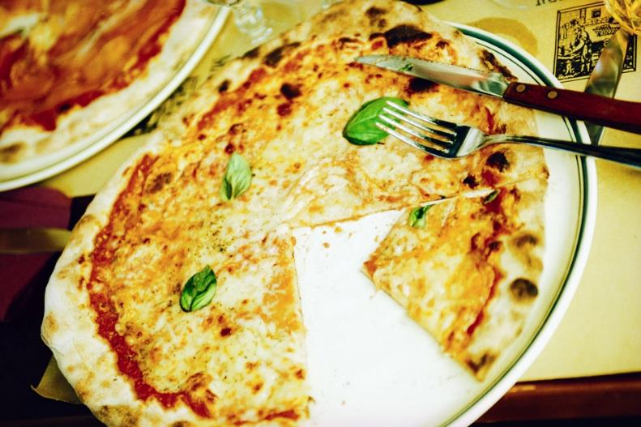
What would we use?

Slide 34
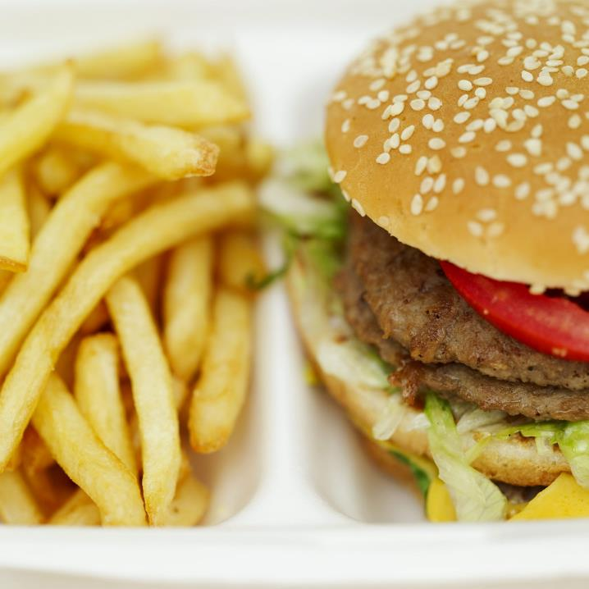
What would
we use?

Slide 35
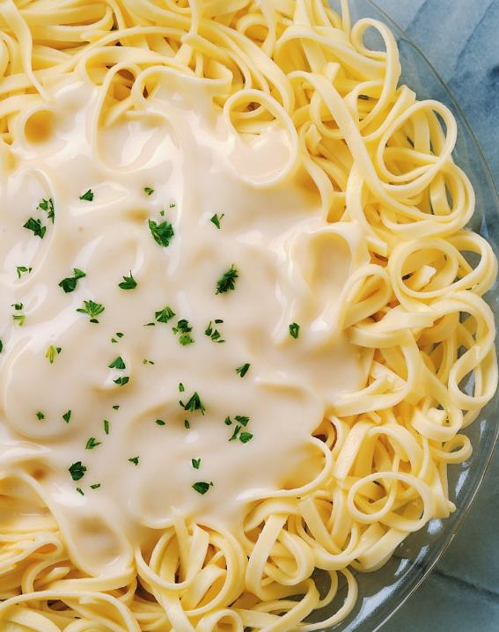
What would we use?

Slide 36
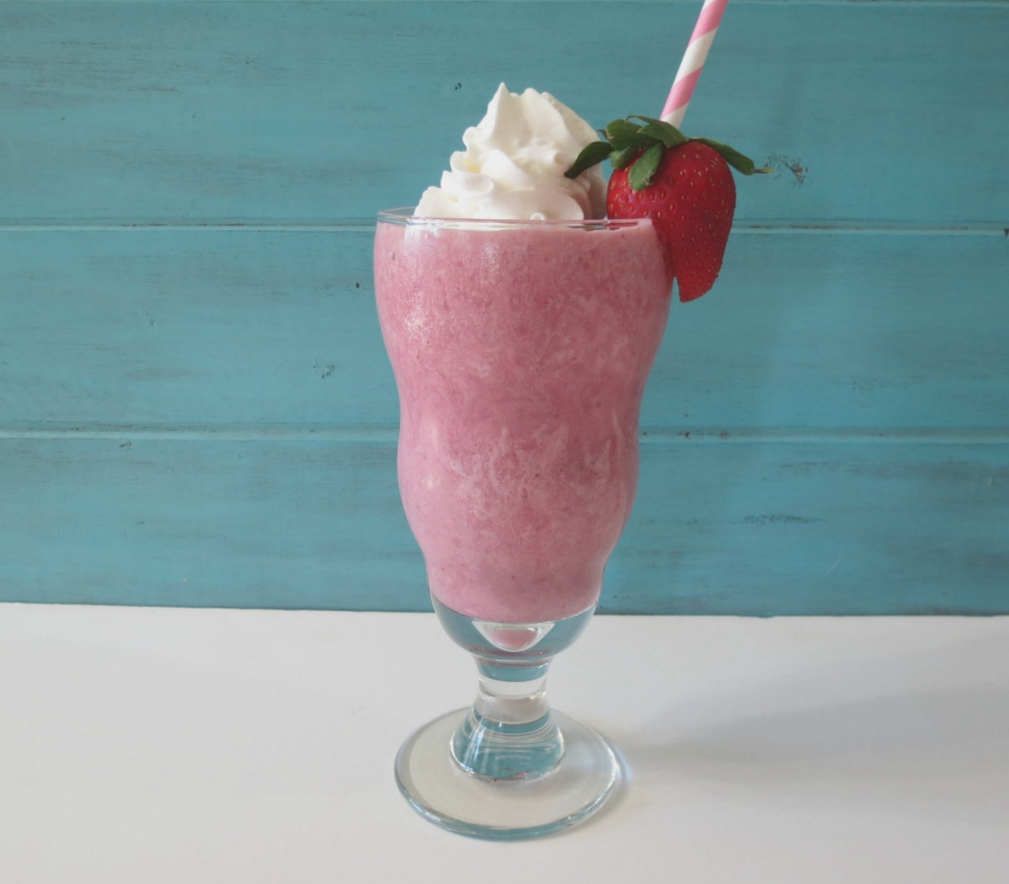
Dry or standard measuring cups, liquid measuring cups, chef’s knife, blender, immersion blender, salad spinner…
what else?

Slide 37
Knife Safety
Jamie’s Dream School video

