Slide 1
What Families Around the World Eat

Slide 2
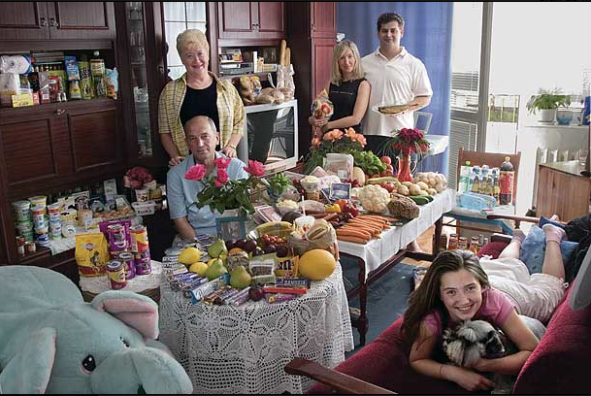
Sobczynscy: Poland, $151.27

Slide 3
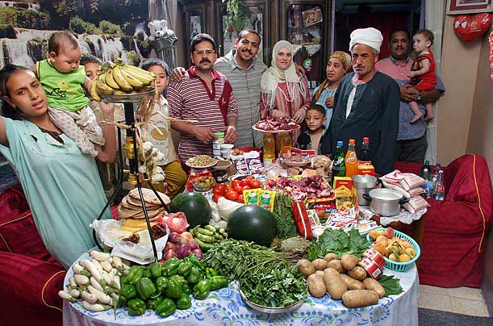
Ahmed: Egypt, $68.53

Slide 4
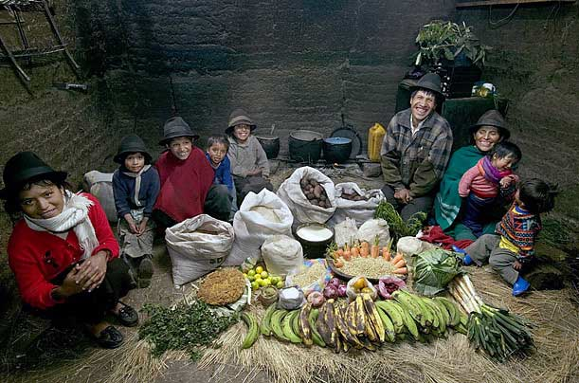
Ayme: Ecuador, $31.55

Slide 5
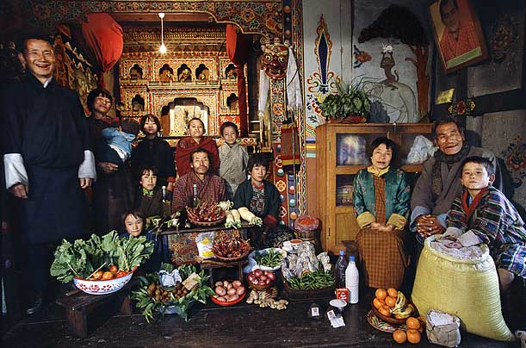
Namgay: Bhutan, $5.03

Slide 6
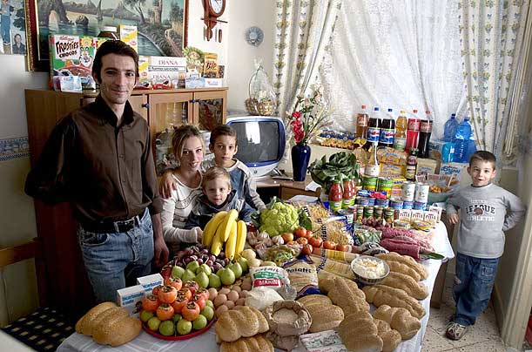
Manzo: Poland, $260.11

Slide 7
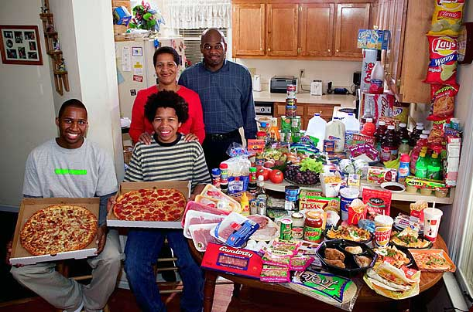
Revis: North Carolina, $341.98

Slide 8
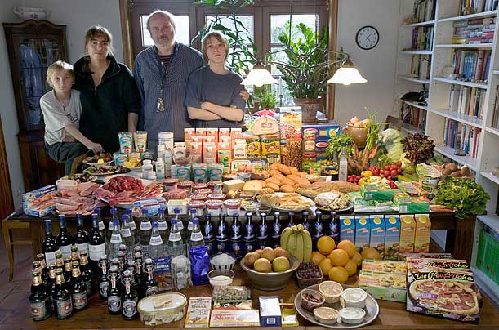
Melander: Germany, $500.07

Slide 9
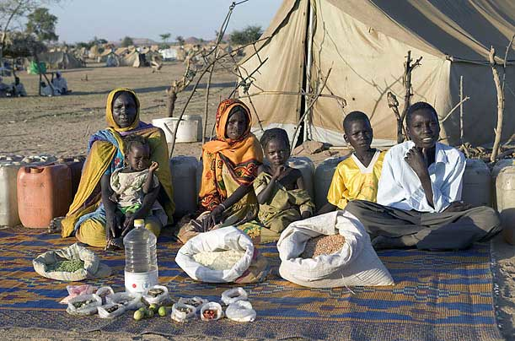
Aboubaker: Chad, $1.23

